Slide 1
Algae, Fungi & Higher Plant Life Cycles
by Bruce K. Kirchoff

Slide 2
Anthophyta

Slide 4
Notes:
anther

Slide 5
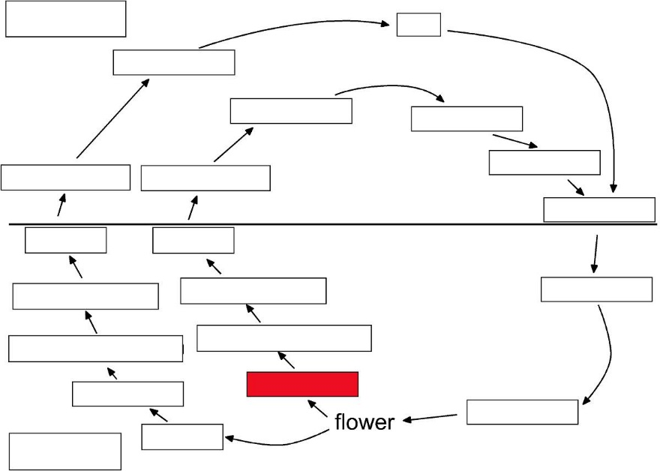
Notes:
anther

Slide 6
anther
Notes:
anther

Slide 7
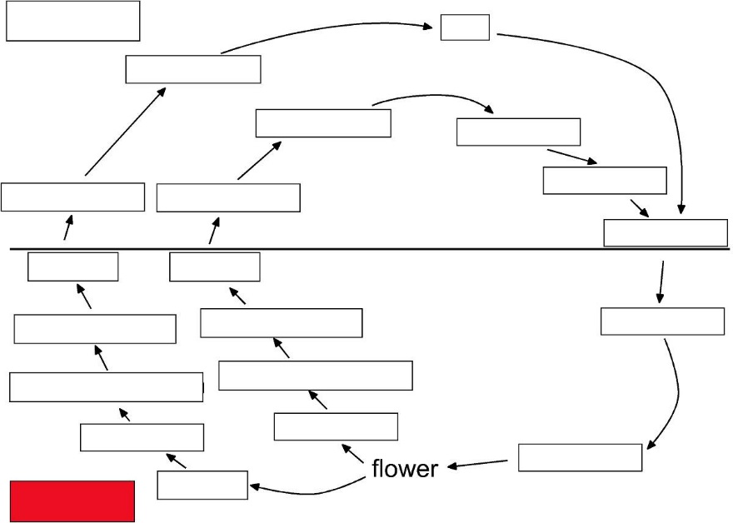
Notes:
diploid

Slide 8
Diploid
Notes:
diploid

Slide 9
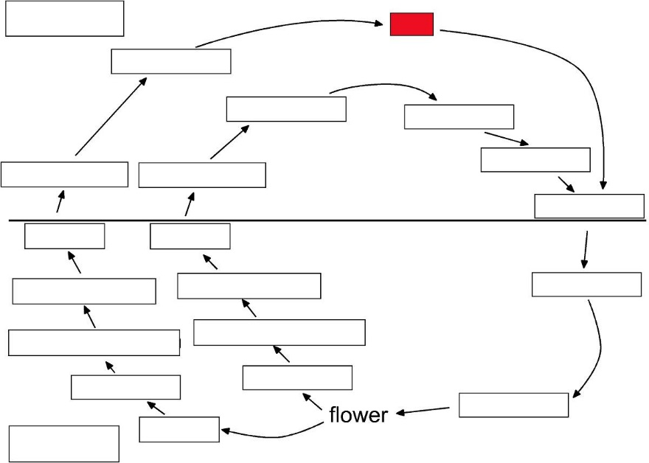
Notes:
egg

Slide 10
egg
Notes:
egg

Slide 11
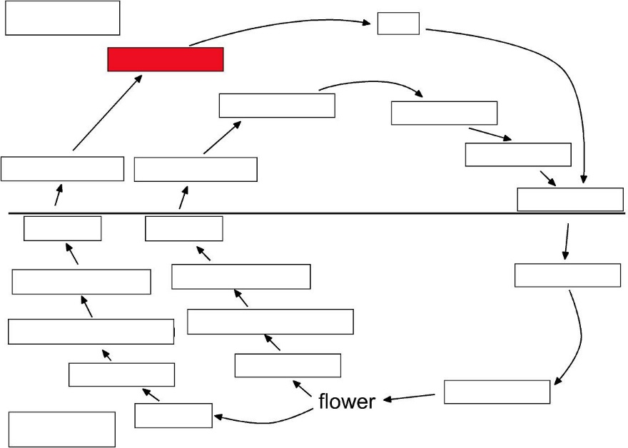

Slide 12
embryo sac

Slide 13
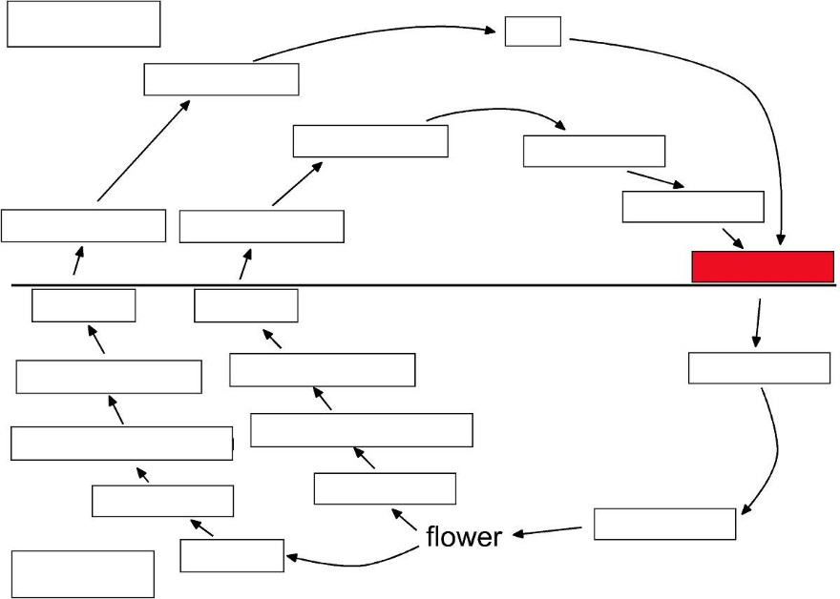

Slide 14
fertilization

Slide 15
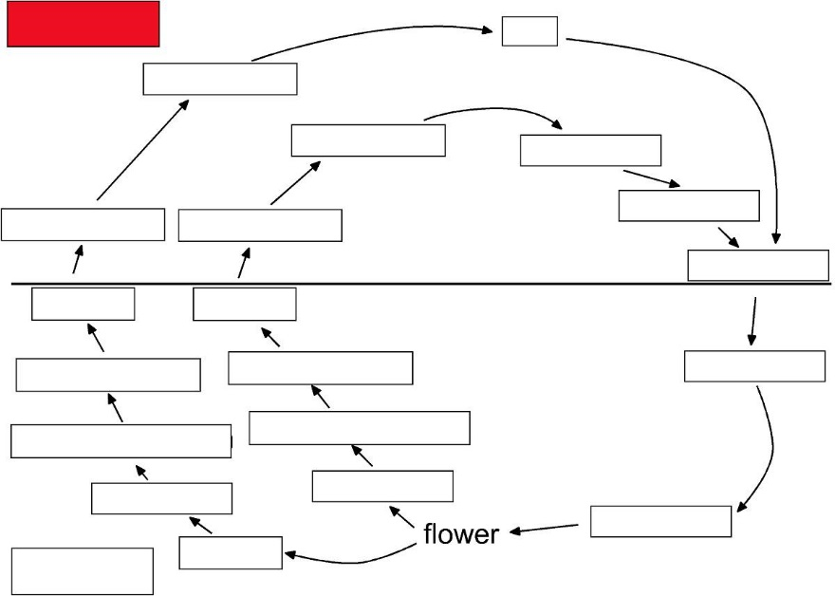

Slide 16
Haploid

Slide 17
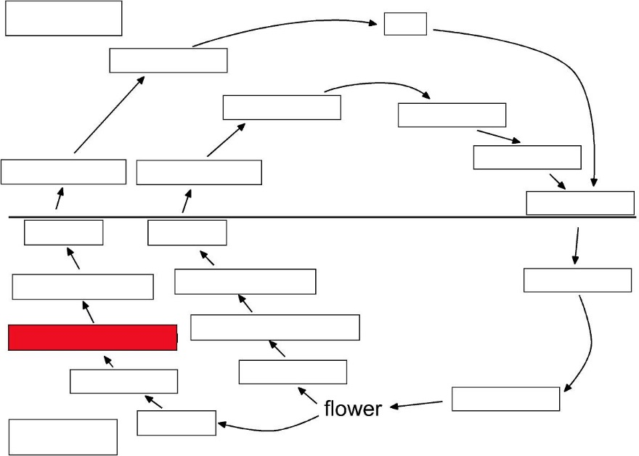

Slide 18
megasporangium

Slide 19
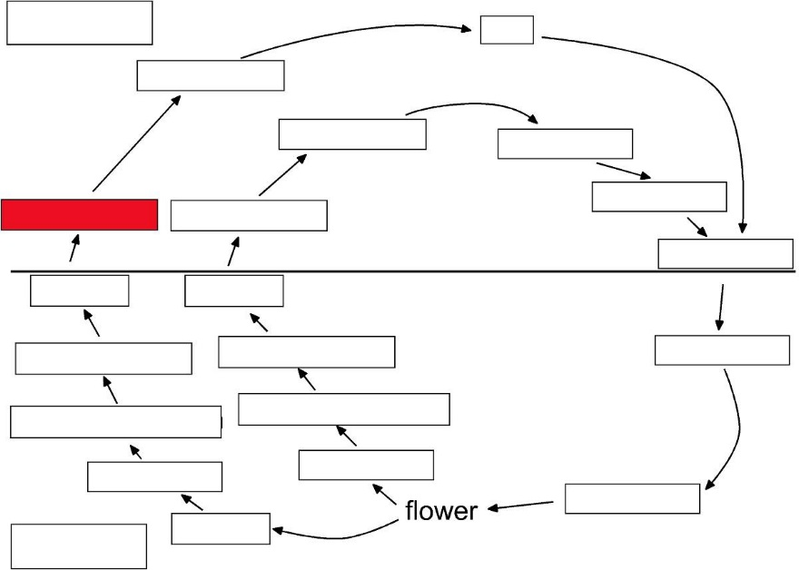

Slide 20
megaspore

Slide 21
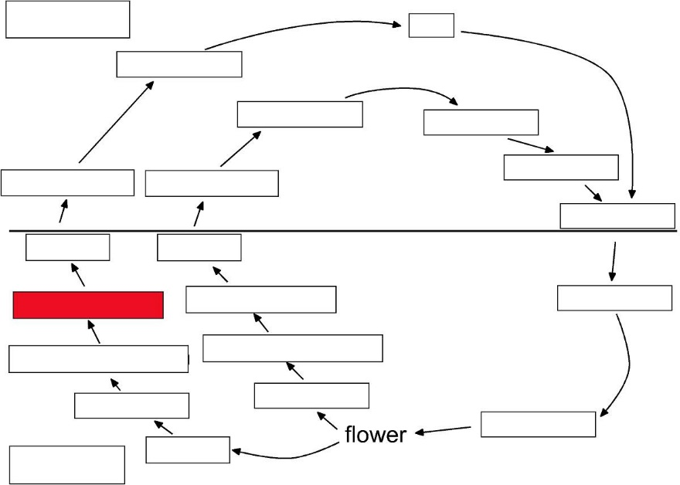

Slide 22
megasporocyte

Slide 23
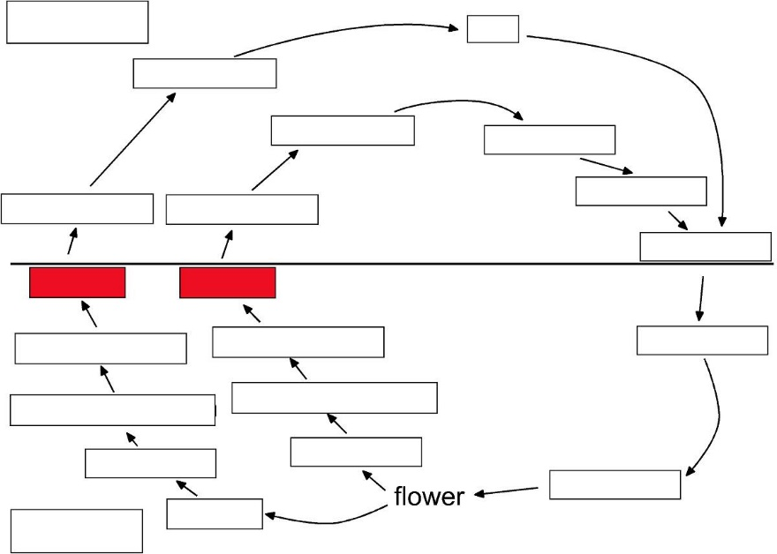

Slide 24
meiosis
meiosis

Slide 25
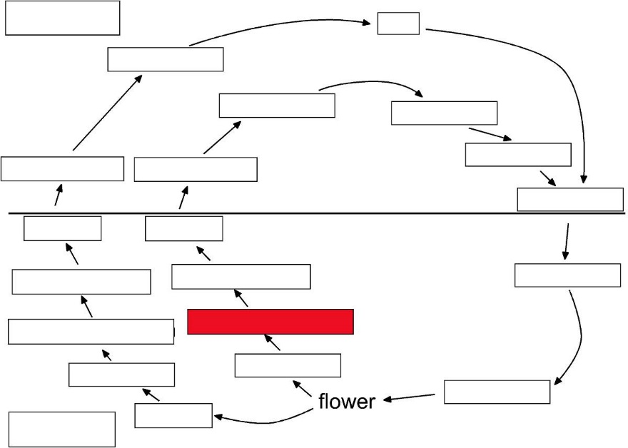

Slide 26
microsporangium

Slide 27
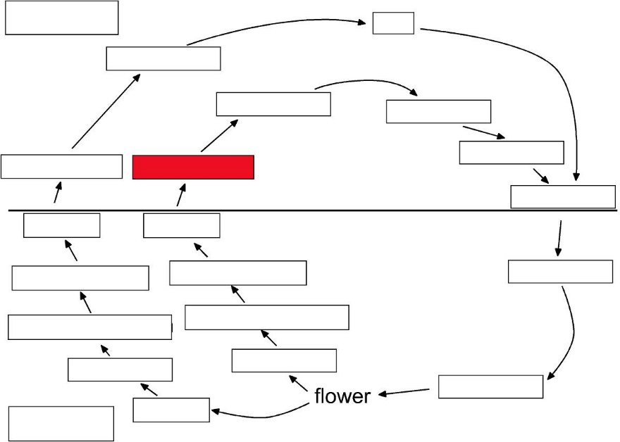

Slide 28
microspores

Slide 29
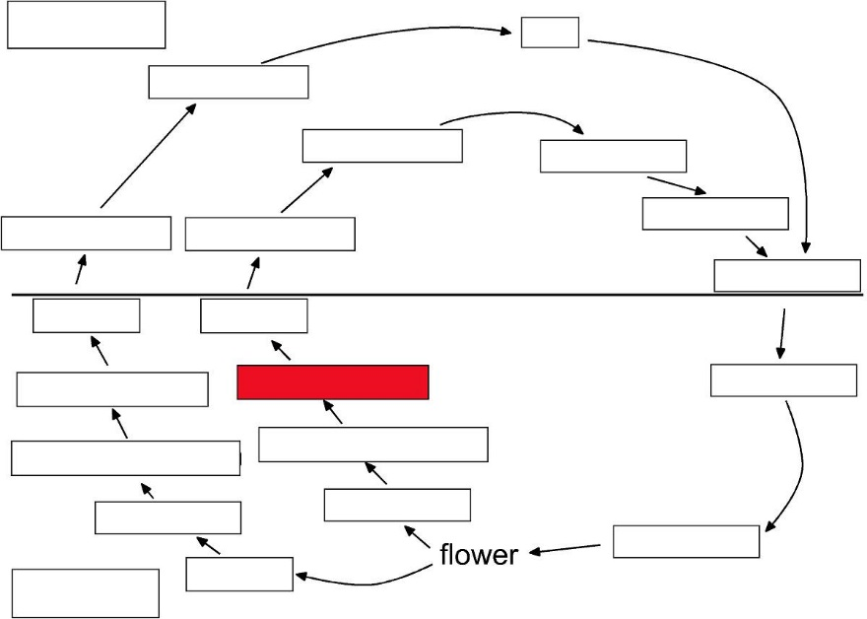

Slide 30
microsporocyte

Slide 31
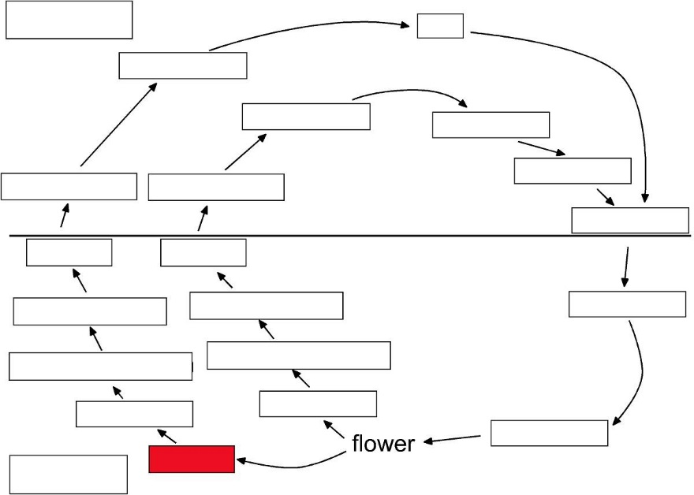

Slide 32
ovary

Slide 33
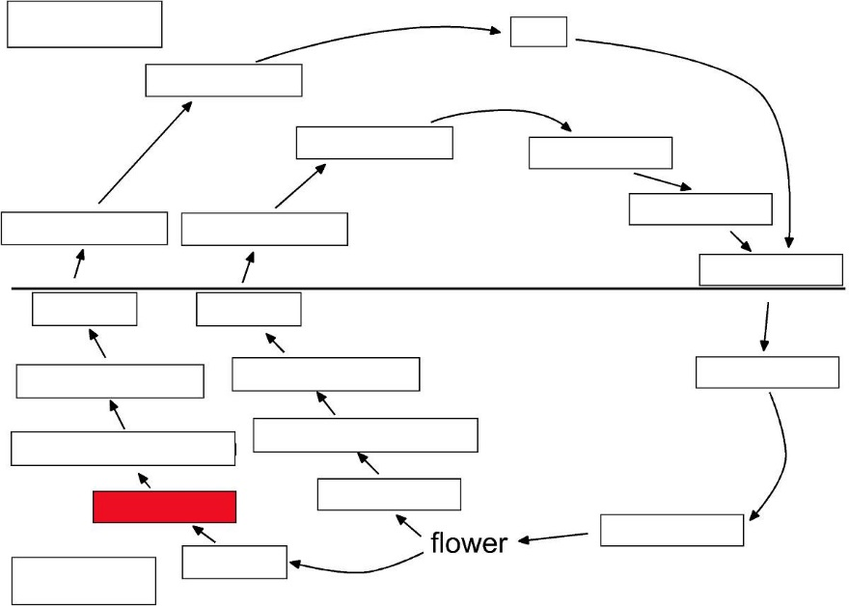

Slide 34
ovule

Slide 35
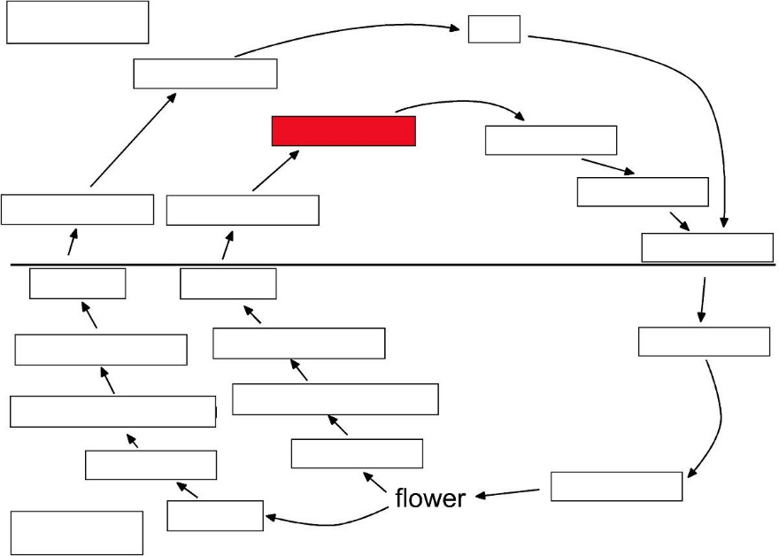

Slide 36
pollen grain

Slide 37
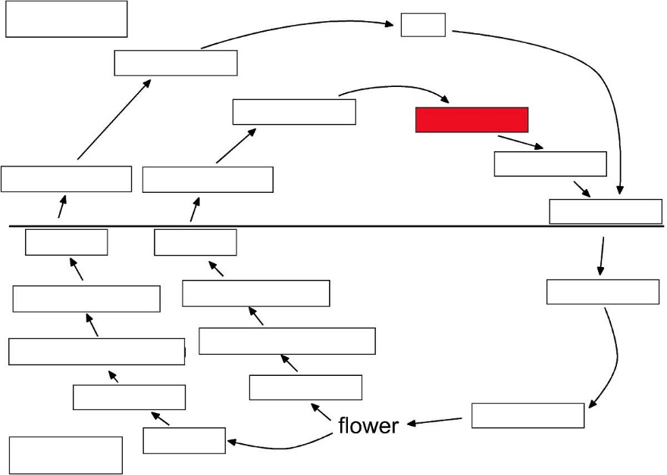

Slide 38
pollen tube

Slide 39
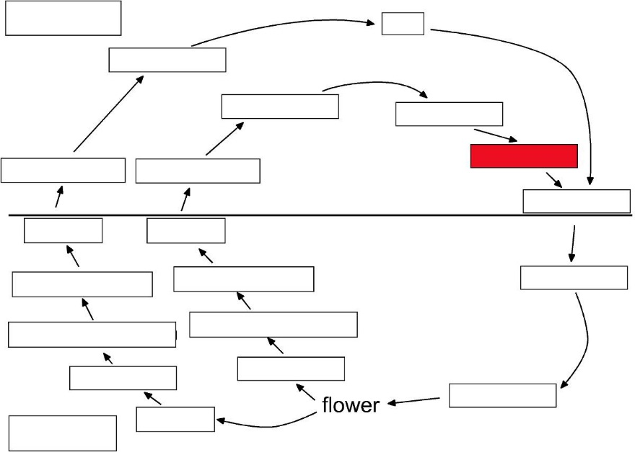

Slide 40
sperm

Slide 41
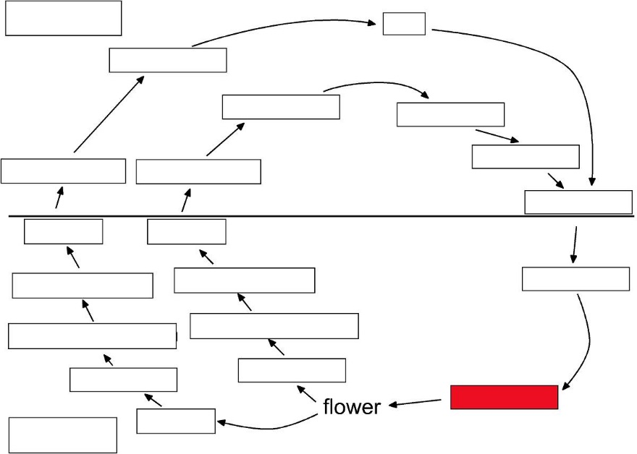

Slide 42
sporophyte

Slide 43
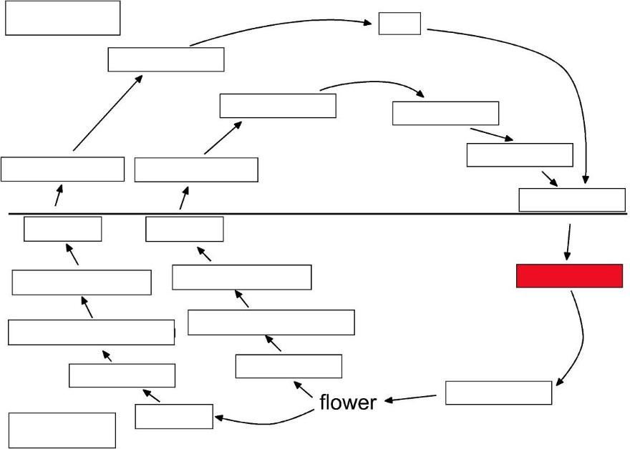

Slide 44
zygote

Slide 45
Ascomycota
Mycelial Ascomycota

Slide 48
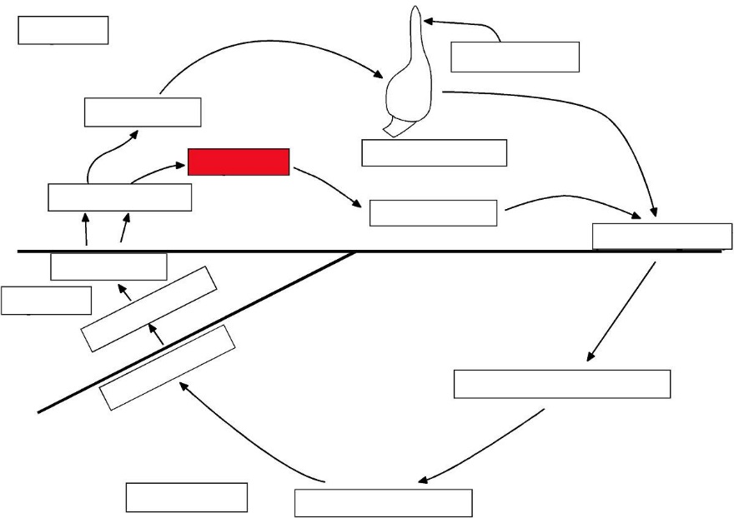

Slide 49
- hyphae

Slide 50
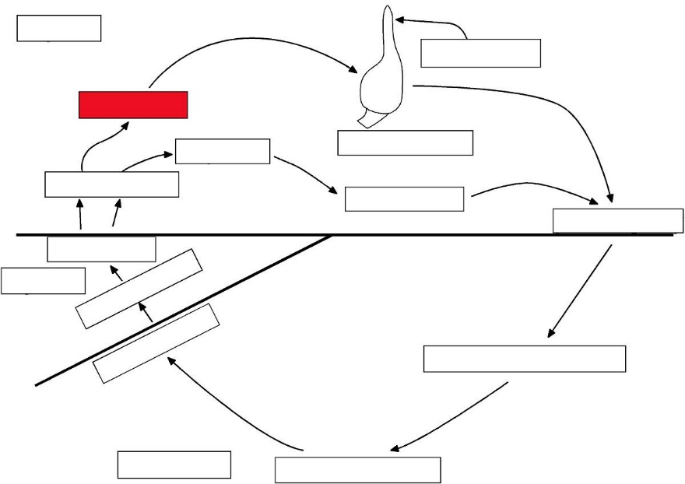

Slide 51
+ hyphae

Slide 52
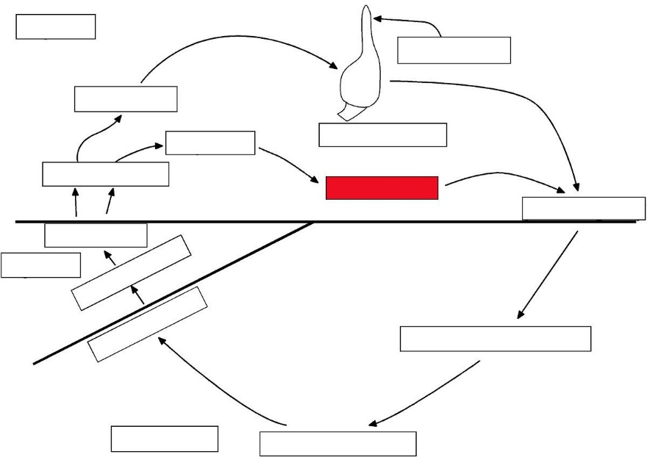

Slide 53
antheridium

Slide 54
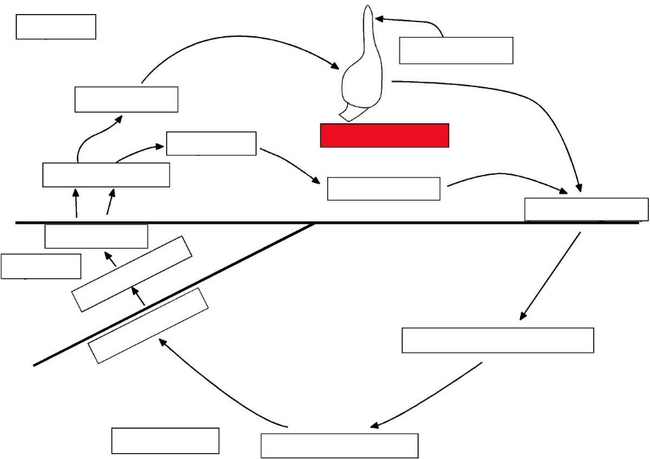

Slide 55
ascogonium

Slide 56
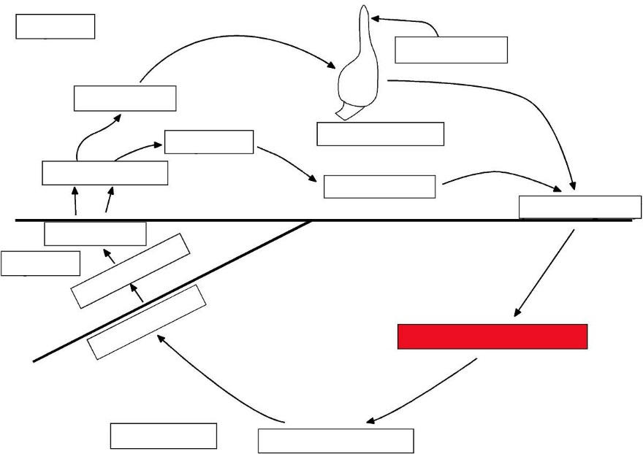

Slide 57
ascogenous hyphae

Slide 58
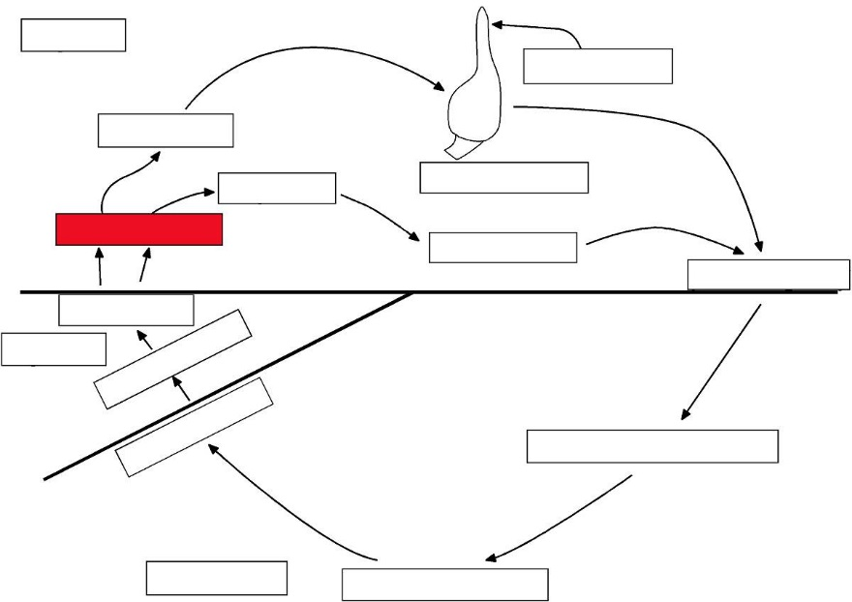

Slide 59
ascospores

Slide 60
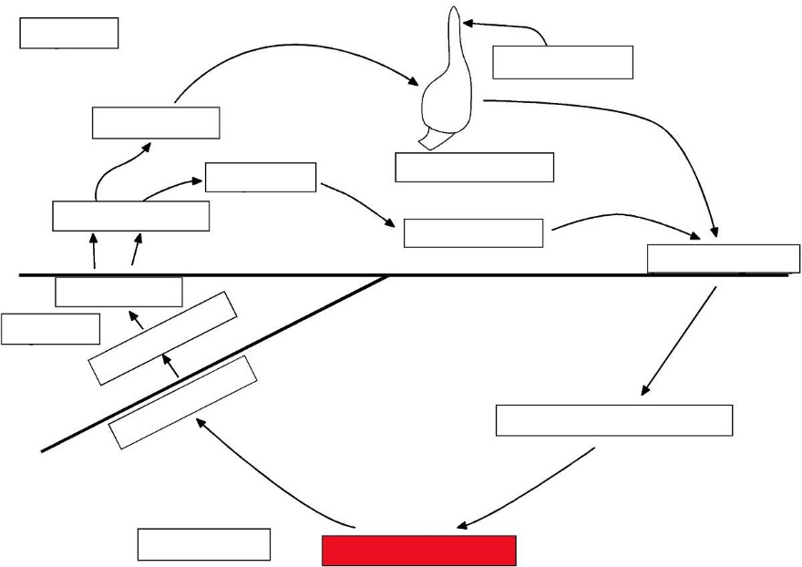

Slide 61
dikaryotic ascus

Slide 62
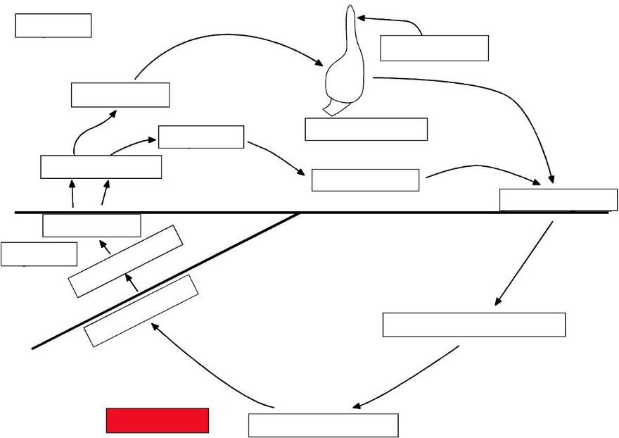

Slide 63
Dikaryotic

Slide 64
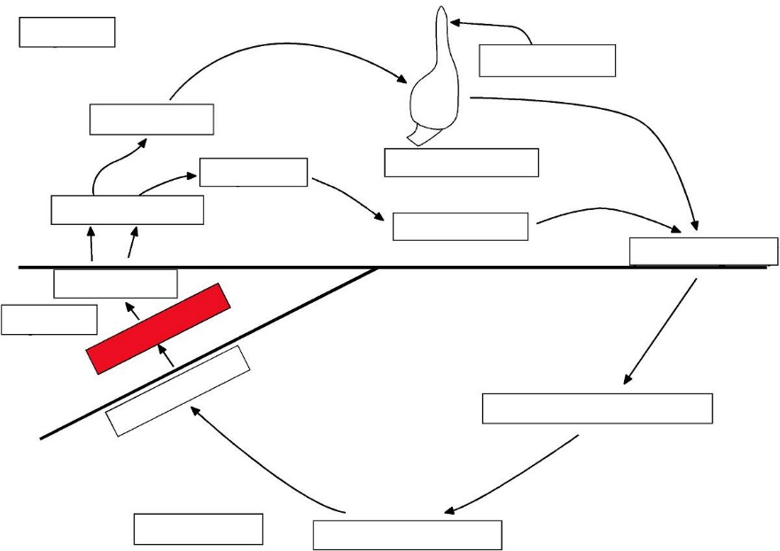

Slide 65
diploid ascus

Slide 66
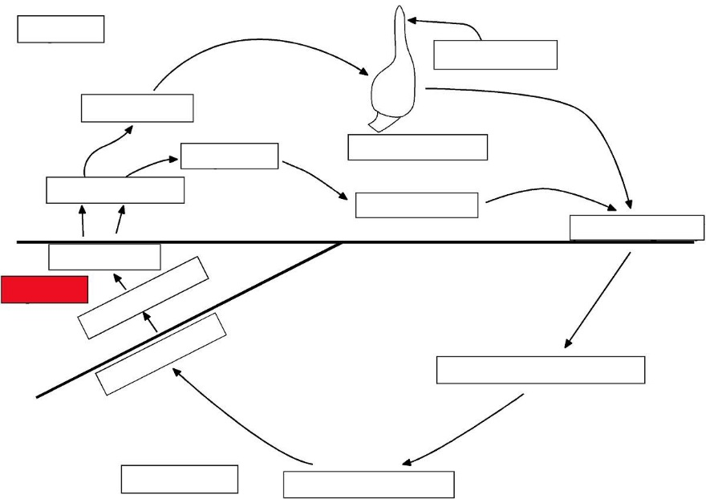

Slide 67
Diploid

Slide 68
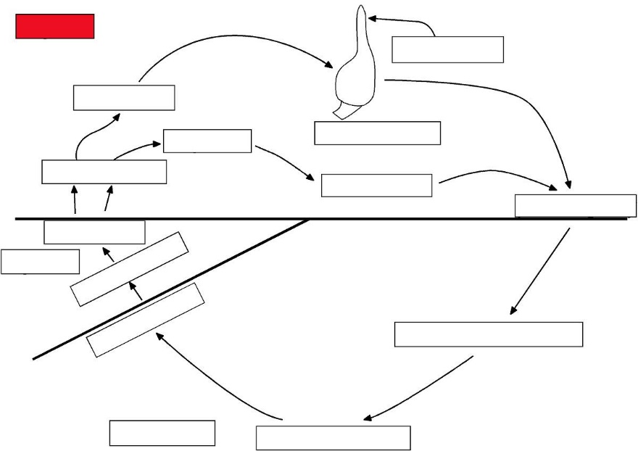

Slide 69
Haploid

Slide 70
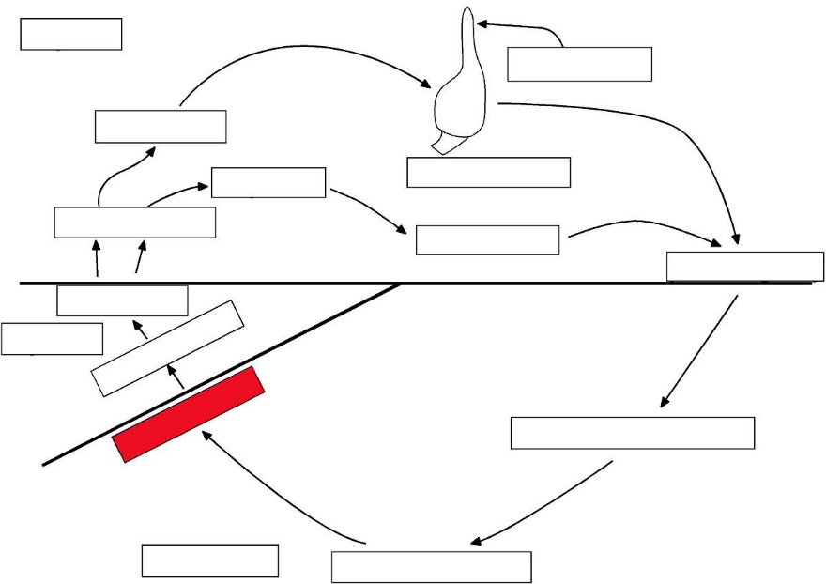

Slide 71
karyogamy

Slide 72
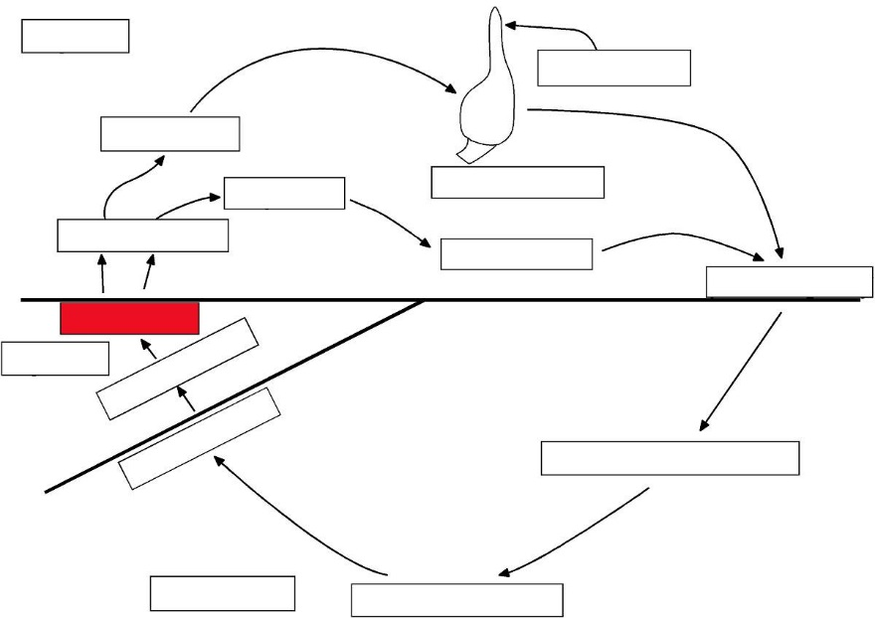

Slide 73
meiosis

Slide 74
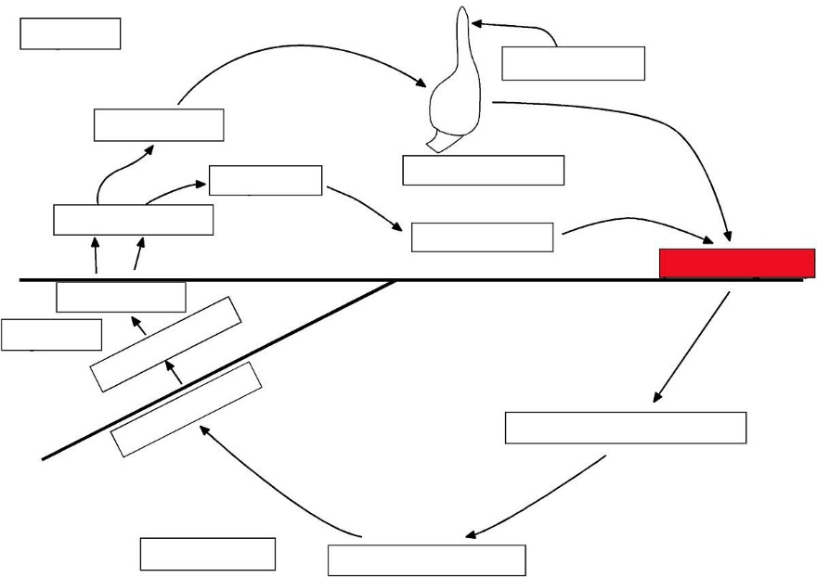

Slide 75
plasmogamy

Slide 76
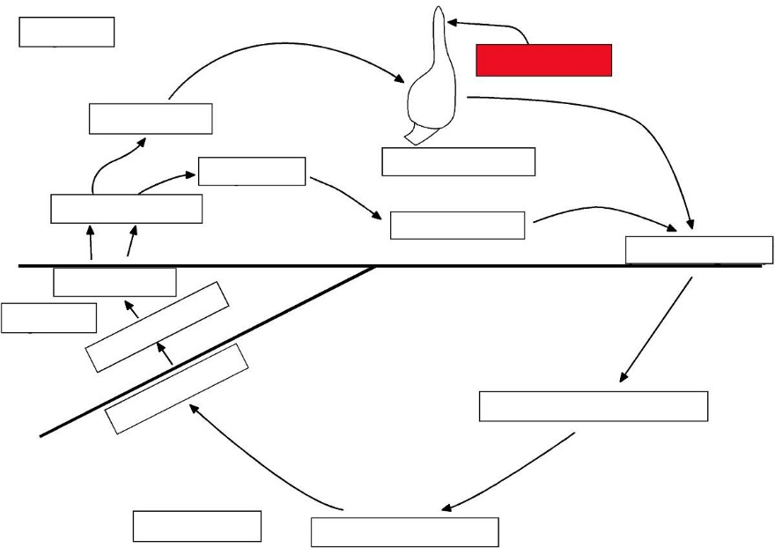

Slide 77
trichogyne

Slide 78
Ascomycota
Saccharomyces (yeast)

Slide 81
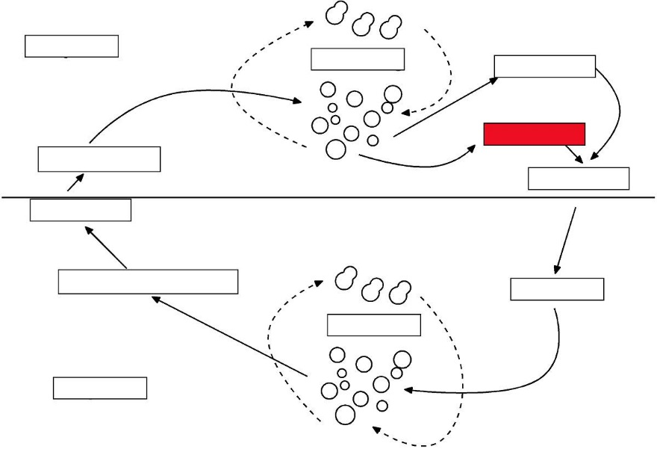

Slide 82
- gamete

Slide 83
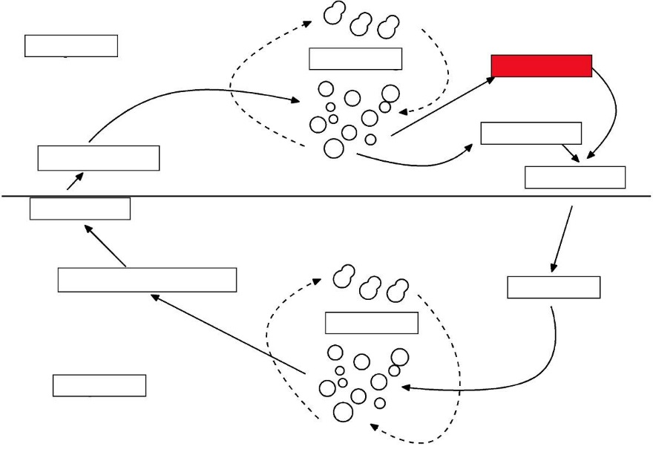

Slide 84
+ gamete

Slide 85
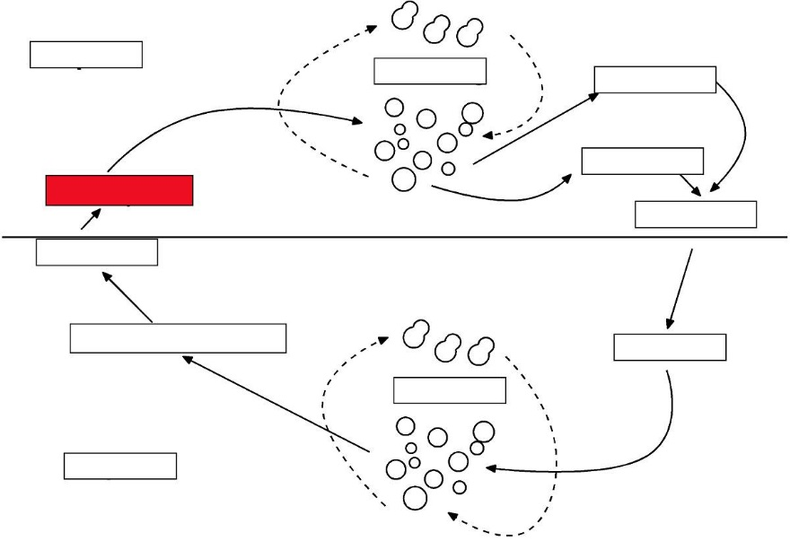

Slide 86
ascospores

Slide 87
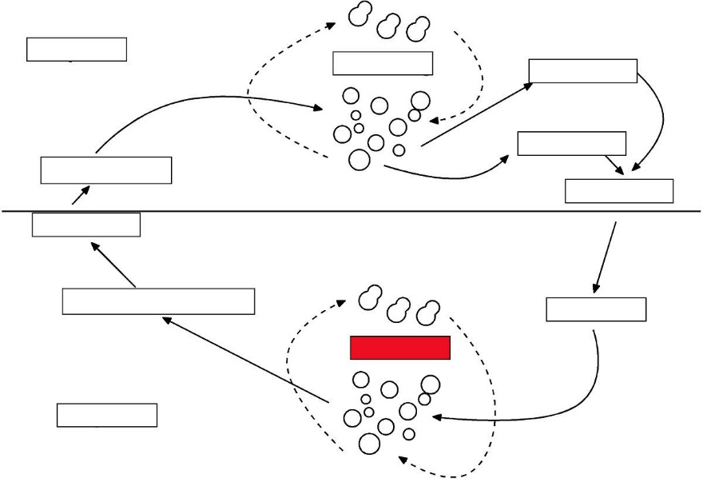

Slide 88
budding

Slide 89
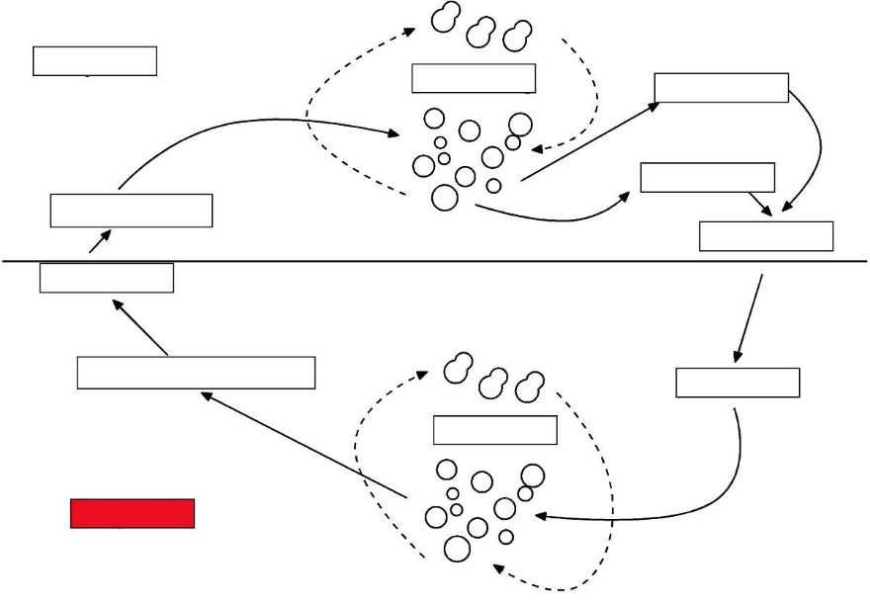

Slide 90
Diploid

Slide 91
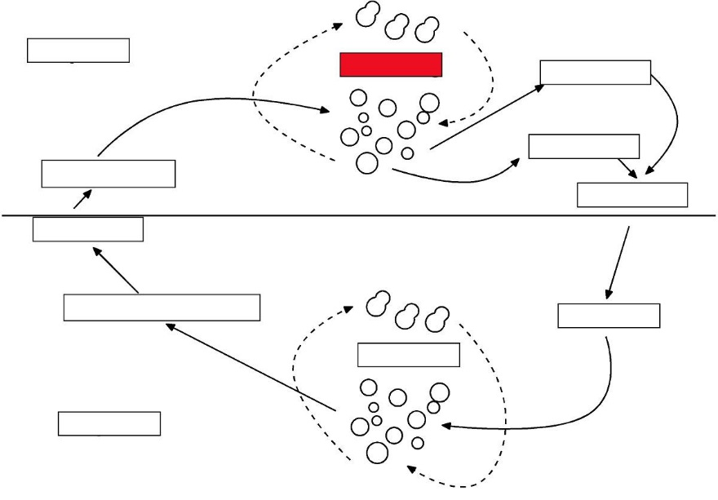

Slide 92
budding

Slide 93
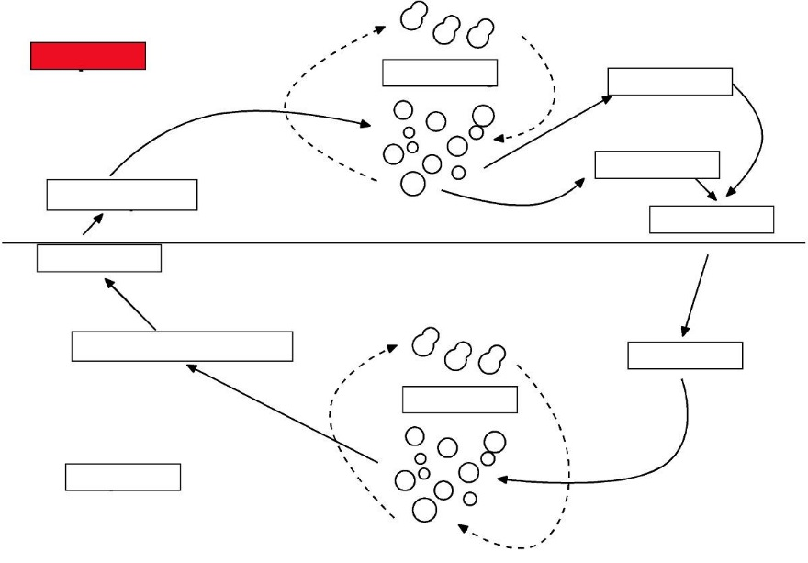

Slide 94
Haploid

Slide 95
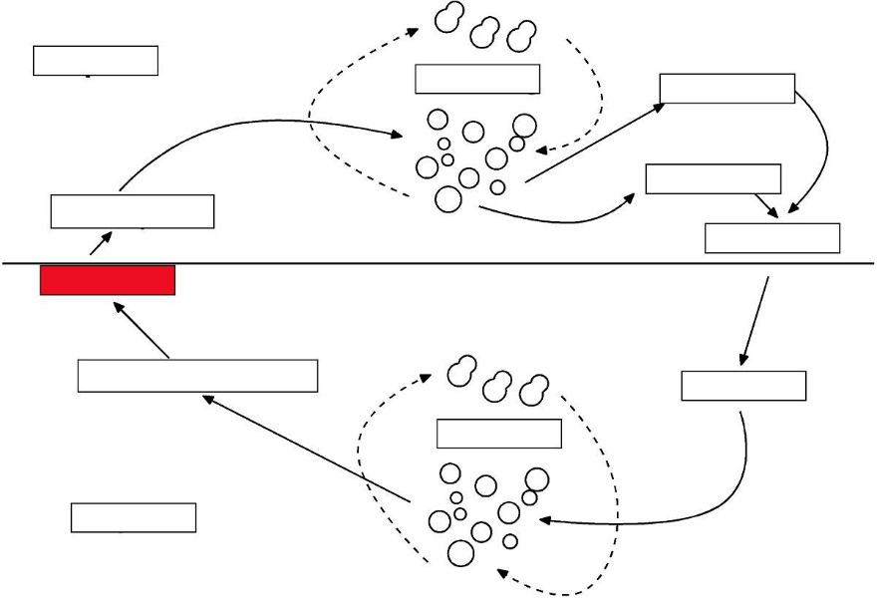

Slide 96
meiosis

Slide 97
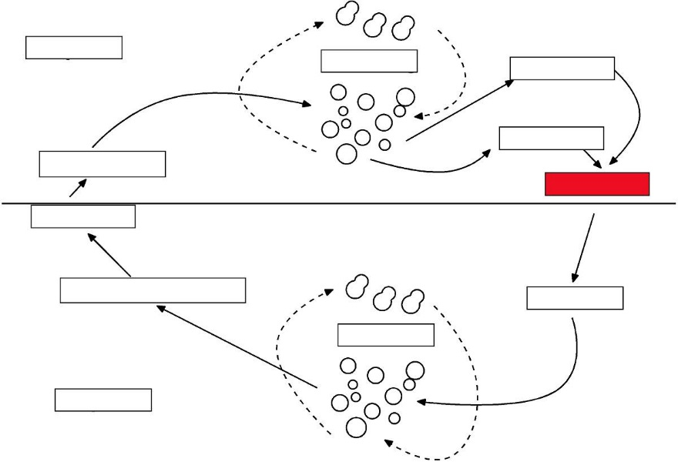

Slide 98
syngamy

Slide 99
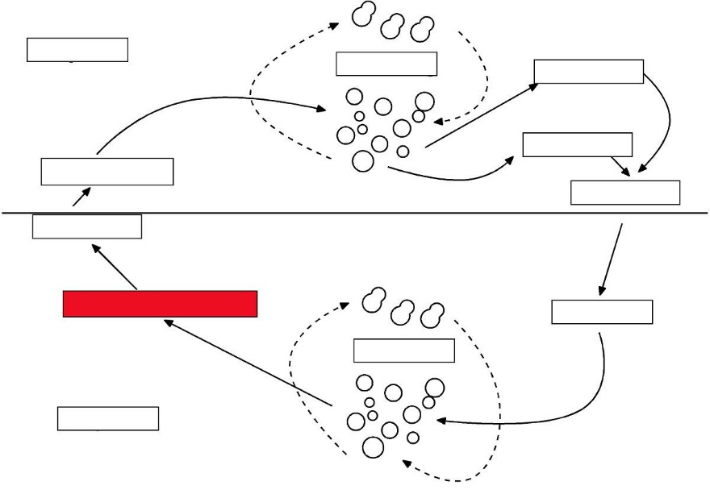

Slide 100
unicellular ascus

Slide 101
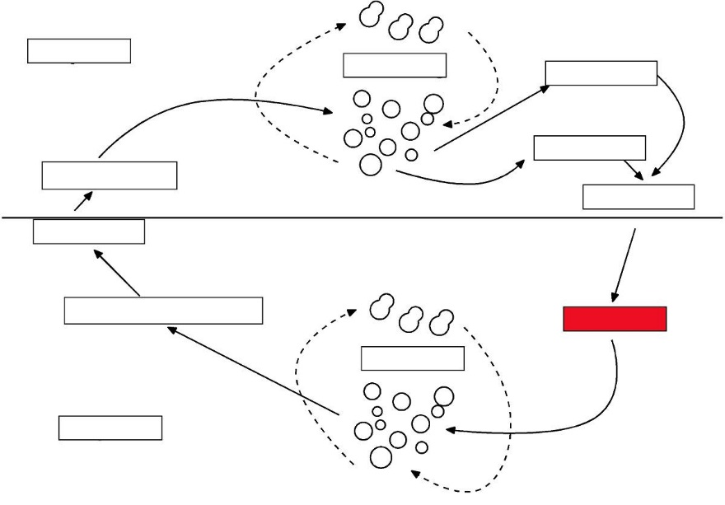

Slide 102
zygote

Slide 103
Coniferophyta

Slide 106
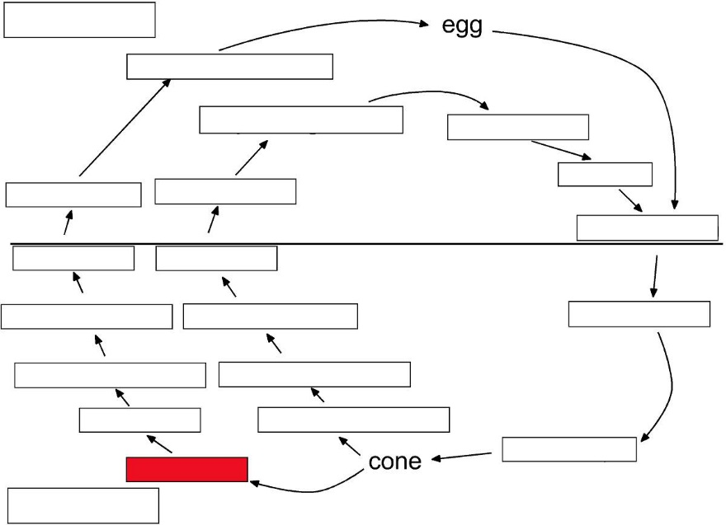

Slide 107
cone scale

Slide 108
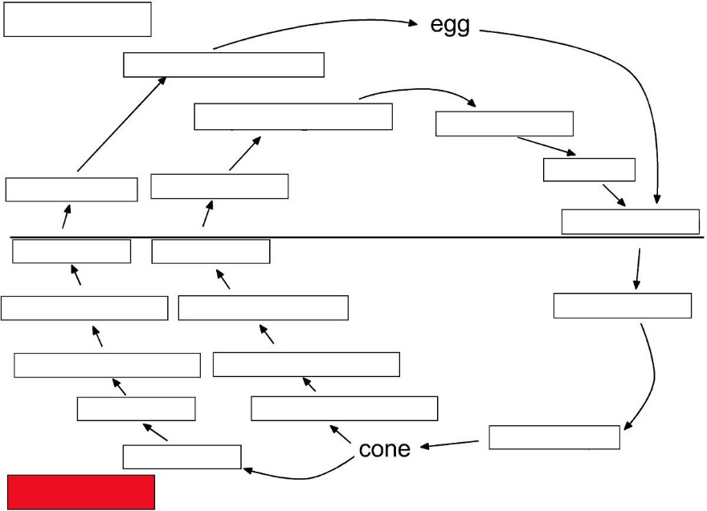

Slide 109
Diploid

Slide 110
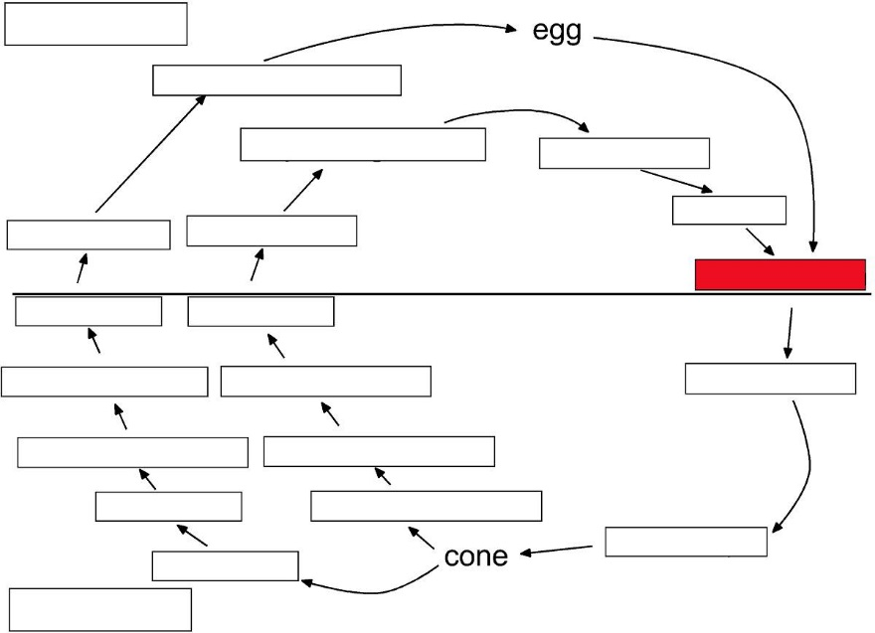

Slide 111
fertilization

Slide 112
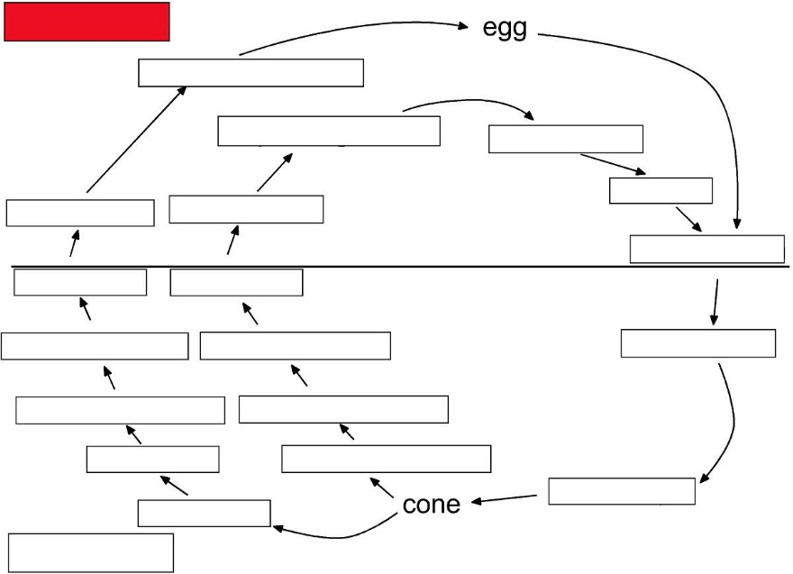

Slide 113
Haploid

Slide 115
megagametophyte

Slide 117
megasporangium

Slide 119
megaspores

Slide 121
megasporocyte

Slide 123
meiosis
meiosis

Slide 125
microsporangium

Slide 127
microspores

Slide 129
microsporocyte

Slide 131
microsporophyll

Slide 133
ovule

Slide 135
pollen grain

Slide 137
pollen tube

Slide 139
sperm

Slide 141
sporophyte

Slide 143
zygote

Slide 144
Cycadophyta

Slide 148
archegonium

Slide 150
Diploid

Slide 152
egg

Slide 154
female sporophyte

Slide 156
fertilization

Slide 158
Haploid

Slide 160
male sporophyte

Slide 162
megagametophyte

Slide 164
megasporangium

Slide 166
microspores

Slide 168
microsporocyte

Slide 170
megastrobilus

Slide 172
meiosis
meiosis

Slide 174
microsporangium

Slide 176
megaspores

Slide 178
megasporocyte

Slide 180
microstrobilus

Slide 182
pollen grain

Slide 184
pollen tube

Slide 186
sperm

Slide 188
zygote
zygote

Slide 189
Basic Dibiontic Life Cycle

Slide 193
- gamete

Slide 195
+ gamete

Slide 197
DIBIONTIC

Slide 199
Diploid

Slide 201
Haploid

Slide 203
meiosis

Slide 205
meiospores

Slide 207
sporangium

Slide 209
syngamy

Slide 211
zygote

Slide 212
Lycophyta
Lycopodium

Slide 216
antheridium

Slide 218
archegonium

Slide 220
Diploid

Slide 222
egg

Slide 224
fertilization

Slide 226
gametophyte

Slide 228
Haploid

Slide 230
meiosis

Slide 232
meiospores

Slide 234
sperm

Slide 236
sporangium

Slide 238
sporocyte

Slide 240
sporophyll

Slide 242
sporophyte

Slide 243
Lycophyta
Selaginella & Isoetes

Slide 247
antheridium

Slide 249
archegonium

Slide 251
Diploid

Slide 253
egg

Slide 255
fertilization

Slide 257
Haploid

Slide 259
megagametophyte

Slide 261
megasporangium

Slide 263
megaspores

Slide 265
megasporcytes

Slide 267
megasporophyll

Slide 269
meiosis

Slide 271
microgametophyte

Slide 273
microsporangium

Slide 275
microspores

Slide 277
microsporocytes

Slide 279
microsporophyll

Slide 281
sperm

Slide 283
sporophyte

Slide 285
strobilus

Slide 286
Basic Monobiontic-Diploid Life Cycle

Slide 290
- gamete

Slide 292
+ gamete

Slide 294
Diploid

Slide 296
Haploid

Slide 298
meiosis

Slide 300
Monobiontic, Diploid

Slide 302
sporangium

Slide 304
syngamy

Slide 306
zygote

Slide 307
Basic Monobiontic-Haploid Life Cycle

Slide 311
- gamete

Slide 313
+ gamete

Slide 315
Diploid

Slide 317
Haploid

Slide 319
meiosis

Slide 321
meiospores

Slide 323
Monobiontic, Haploid

Slide 325
syngamy

Slide 327
zygote

Slide 328
Myxomycota

Slide 331
- gamete

Slide 333
+ gamete

Slide 335
amoebas

Slide 337
Diploid

Slide 339
flagellated cells

Slide 341
Haploid

Slide 343
meiosis

Slide 345
meiospores

Slide 347
plasmodium

Slide 349
sclerotium

Slide 351
sporangium

Slide 353
syngamy

Slide 355
zygote

Slide 356
Phaeophyta
Laminaria

Slide 360
Diploid

Slide 362
egg

Slide 364
female gametophyte

Slide 366
fertilization

Slide 368
Haploid

Slide 370
male gametophyte

Slide 372
meiosis

Slide 374
meiospores

Slide 376
sperm

Slide 378
sporophyte

Slide 380
unilocular sporangium

Slide 382
zygote

Slide 383
Psilotophyta

Slide 387
antheridium

Slide 389
archegonium

Slide 391
Diploid

Slide 393
egg

Slide 395
fertilization

Slide 397
gametophyte

Slide 399
Haploid

Slide 401
meiosis

Slide 403
meiospores

Slide 405
sperm

Slide 407
synangium

Slide 409
sporocyte

Slide 411
sporophyte

Slide 413
zygote

Slide 414
Pteridophyta
leptosporangiate ferns

Slide 418
archegonium

Slide 420
bisexual
gametophyte

Slide 422
Diploid

Slide 424
egg

Slide 426
fertilization

Slide 428
Haploid

Slide 430
leptosporangium

Slide 432
male
gametophyte

Slide 434
meiosis

Slide 436
meiospores

Slide 438
sperm

Slide 440
sporophyte

Slide 442
zygote

Slide 443
Rhodophyta
Polysiphonia

Slide 447
carpogonium

Slide 449
carposporangium

Slide 451
carpospores

Slide 453
carposporophyte

Slide 455
Diploid

Slide 457
female gametophyte

Slide 459
Haploid

Slide 461
male gametophyte

Slide 463
meiosis

Slide 465
monospores

Slide 467
spermatangia

Slide 469
spermatia

Slide 471
syngamy

Slide 473
tetrasporangium

Slide 475
tetraspores
tetraspores

Slide 477
tetrasporophyte

Slide 479
trichogyne

Slide 481
zygote

Slide 482
Teliomycetes
Puccinia

Slide 485
aecia

Slide 487
aeciospores

Slide 489
basidiospores

Slide 491
Dikaryotic

Slide 493
diploid teliospores

Slide 495
Haploid

Slide 497
karyogamy

Slide 499
plasmogamy

Slide 501
receptive hyphae

Slide 503
spermogonium

Slide 505
telia

Slide 507
teliospores

Slide 509
uredinia

Slide 511
urediniospores

Slide 512
Ulvophyceae
Cladophora

Slide 516
- gamete

Slide 518
+ gamete

Slide 520
Diploid

Slide 522
Haploid

Slide 524
meiosis

Slide 526
meiospores

Slide 528
parthenogeneiss
parthenogeneiss

Slide 530
sporangium

Slide 532
syngamy

Slide 534
zoospores

Slide 536
zygote

Slide 537
Ulvophyceae
Ulva

Slide 541
-gamete

Slide 543
+ gamete

Slide 545
Asexual reproduction

Slide 547
Diploid

Slide 549
gametophyte
gametophyte

Slide 551
Haploid

Slide 553
meiosis

Slide 555
meiospores
meiospores

Slide 557
parthenogenesis

Slide 559
sporophyte

Slide 561
syngamy

Slide 563
zoospores

Slide 565
zygote

