Slide 1
Introduced and Invasive Species Terminology
Native species: a species that occurs naturally in a specified geographic area and has coevolved with the species around it (typically based on whether it was here prior to European contact)
Introduced species: a species brought to a new geographic area intentionally or unintentionally by humans (also called alien, exotic, non-native)
Invasive species: an established/naturalized (i.e., self-sustaining and reproducing) species that causes harm to the economy, environment, or human well-being.
Another primer on invasive species: https://www.youtube.com/watch?v=yIgysZ5Hho8
Notes:
Discuss the differences between native, introduced, and invasive species. Youtube video on invasive species provided if interested.

Slide 2
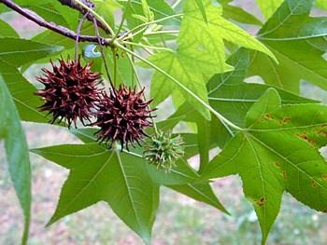
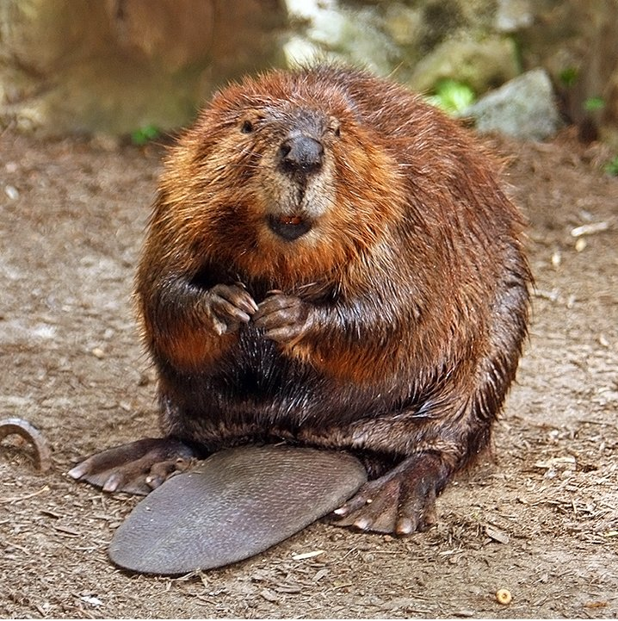
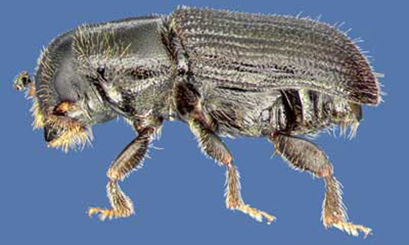
Native species can be “invasive” too…
Notes:
Discuss how, though we often only think of non-native species as invasive, some native species can be considered invasive too. For example, many southerners and Midwesterners view sweetgum and eastern red cedar as invasive because they grow everywhere and are difficult to get rid of. Beavers and Canada geese are sometimes considered pests or invasive, though they are native. Southern pine beetle and mountain pine beetle are native insects, but go through cycles of outbreaks, killing pine trees in North America, thus they are viewed as pests. Didymo (or rock snot) is a diatom native to the Northern Hemisphere, including North America, but is considered a nuisance in waterways in North America.

Slide 3
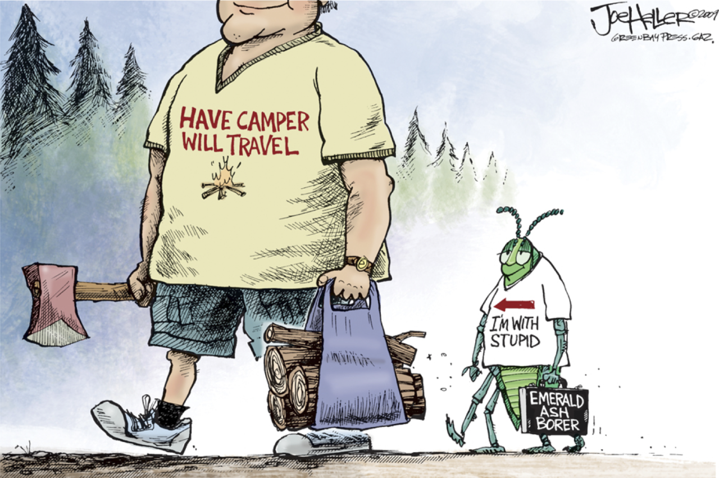
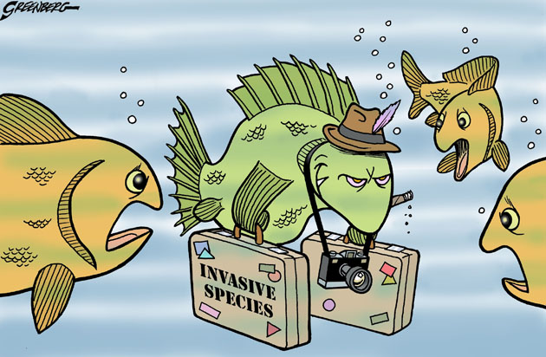
Human Perceptions of Introduced & Invasive Species
Some people view all introduced and invasive species as “bad”
All introduced species should be prevented or eradicated, if possible, to limit the risk of them establishing and becoming invasive
Notes:
This slide starts discussion about human perceptions of introduced and invasive species, starting with the perception that all non-native and invasive species are bad.

Slide 4
Human Perceptions of Introduced & Invasive Species
Some people view humans as part of the global environment and think humans are the invasive species
All management that needs to be done is to correct for human mistakes and human impacts on the landscape
Notes:
Some people don’t view introduced and invasive species as “bad” but rather as a side effect of human movement and mistakes, with humans being the bad part of the global environment.

Slide 5
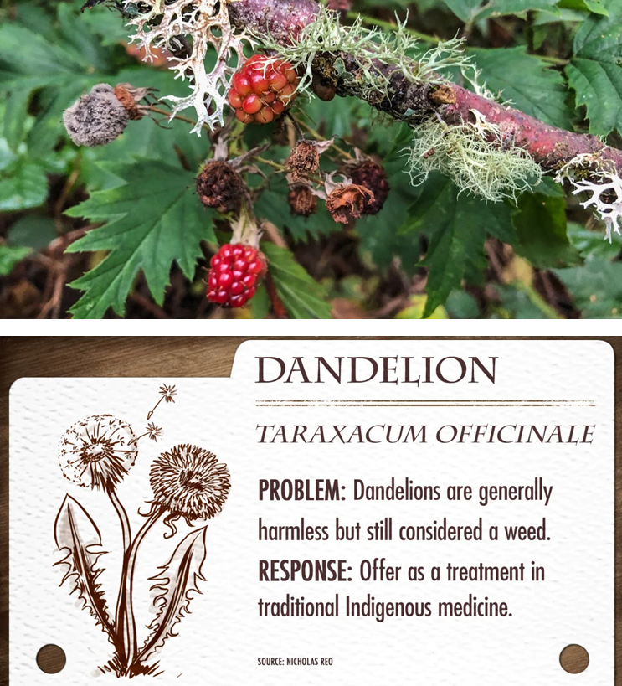
Human Perceptions of Introduced & Invasive Species
Some Indigenous perspectives regard introduced species as displaced relatives and useful…
“The irony is that for many who are in the environmental sciences, most of these invasive species are their plant relatives as these were introduced during colonial times by settlers and colonizers. This means that many people have lost their ancestral roots due to assimilation and, as a result, they have lost their relationships with the same plants they now deem as terrible beings. Regardless of whether this plant belongs there or not, we must ask its spirit for permission. We acknowledge them as displaced relatives, since at the end of the day, they are also someone’s plant relatives.” – Dr. Jessica Hernandez
https://www.popsci.com/environment/fresh-banana-leaves-jessica-hernandez-excerpt/
“Introduced plants, like native plants, are regarded as persons that have their own intelligence, role, and way of being. What are they bringing us? What are they trying to teach us?” -Dr. Robin Wall Kimmerer
https://www.biohabitats.com/newsletter/traditional-ecological-knowledge/leaf-litter-talks-with-dr-robin-wall-kimmerer/
“Every plant and animal is useful to us.” – Dr. Nicholas Reo
https://www.cbc.ca/radio/unreserved/earth-day-indigenous-scientists-academics-and-community-members-take-the-lead-in-environmental-causes-1.4605336/every-plant-and-animal-is-useful-to-us-indigenous-professor-re-thinking-how-we-deal-with-invasive-species-1.4605344
Notes:
Indigenous peoples view these species as displaced beings, potentially useful, and can teach us about the environment and interactions within the environment.

Slide 6
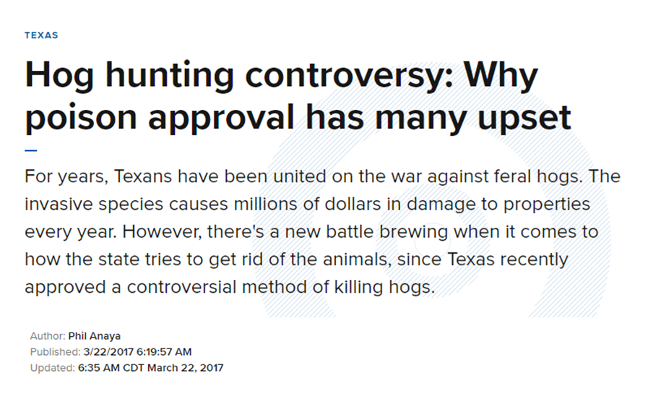
Human Perceptions of Introduced & Invasive Species
Some view invasive species as a possible source of food or products that can be used by humans or other animals.
Naturalized invasive species have worked their way into local traditions (e.g., people relying on hunting feral hogs for food/tradition)
Notes:
Some western viewpoints also view these species as “useful” and can be a source of food. Some species have been around long enough that they have worked their way into traditions of certain cultures (e.g., hunting feral hogs in poor, white communities in the mid-South).

Slide 7
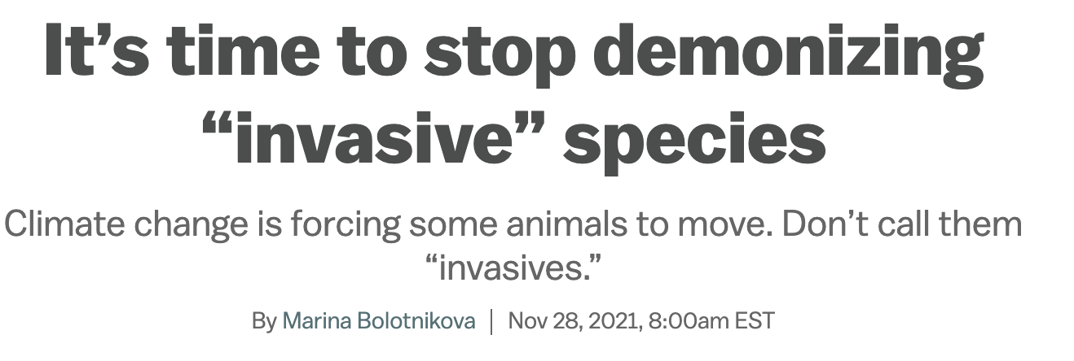
Human Perceptions of Introduced & Invasive Species
Notes:
Some people are even pushing to stop demonizing introduced and invasive species because they “aren’t all bad.”

Slide 8
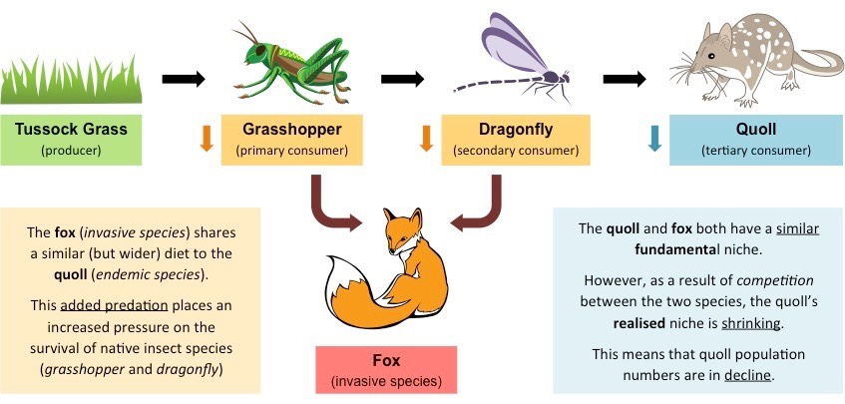
Are all introduced species bad? What impacts can they have?
Notes:
This question of “are introduced species bad?” is not black and white. Most have negative impacts, but a few have neutral or positive impacts. The image here just helps students see how invasive species can affect food webs and the other species around them directly and indirectly.

Slide 9
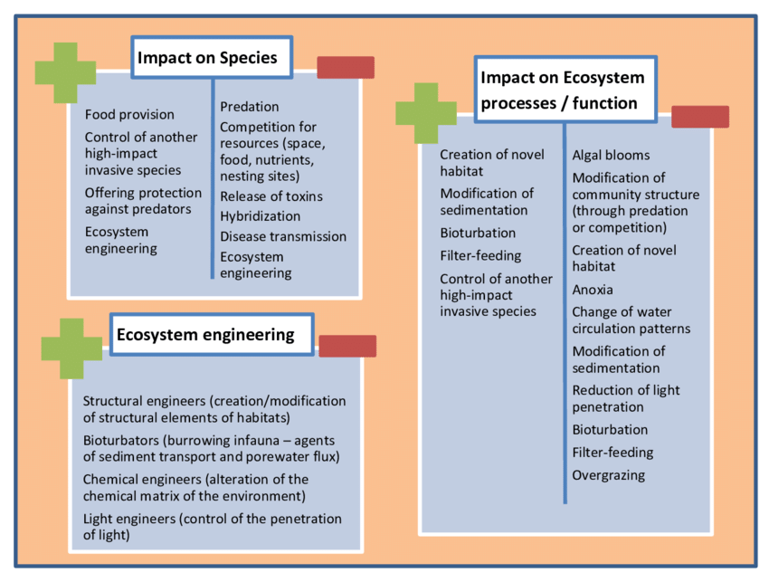
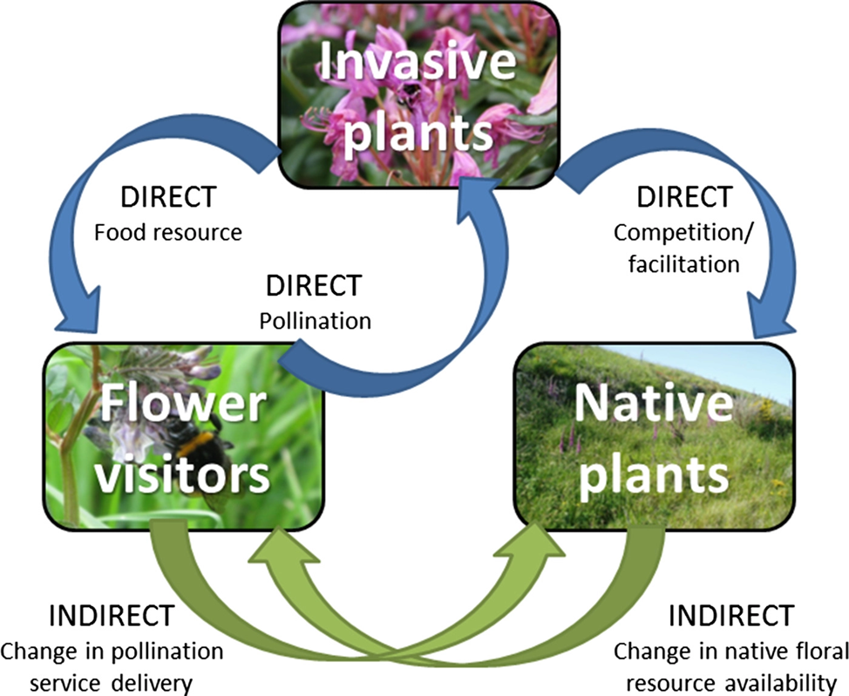
Introduced Species Impacts
Notes:
This slide includes some more general impacts of introduced species, positive and negative. In lieu of this, you could challenge students to come up with a list of their own. Challenge them to think about the bad effects species can have, as well as good effects. You could also compose this list after completing the jigsaw activity.

