Slide 1
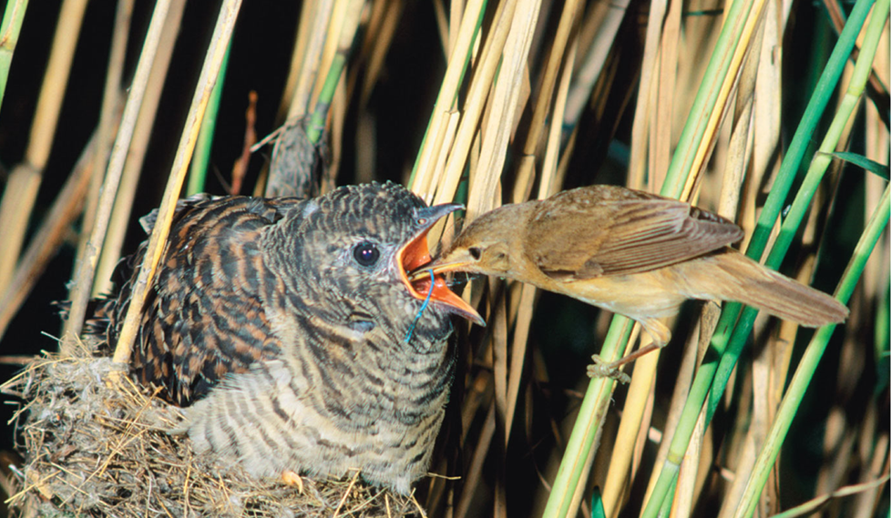
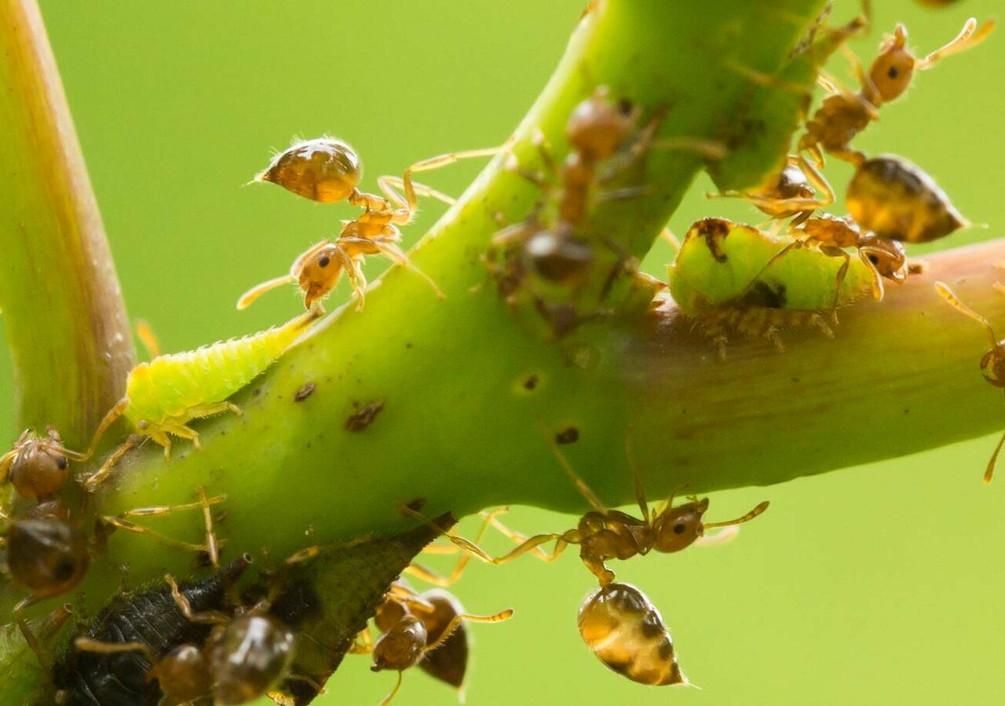
Species Interactions

Slide 2
Species interactions
Interaction Type | Species 1 | Species 2
Amensalism | – | 0
Commensalism | + | 0
Competition | – | –
Mutualism | + | +
Neutral | 0 | 0
Parasitism | + | –
Parasitoidism | + | –
Predation | + | –
Species interactions are classified based on reciprocal effects
i.e., the effect of one species population on the other species populations
positive (+), detrimental (−), or neutral or no effect (0)
https://www.youtube.com/watch?v=rNjPI84sApQ
Notes:
Provide introduction to or refresher on species interactions so students know what interactions to look for during the jigsaw. Summarize all possible effects species can have on one another, whether positive, negative, or neutral. Youtube video provides good overview of a lot of these species interactions.

Slide 3
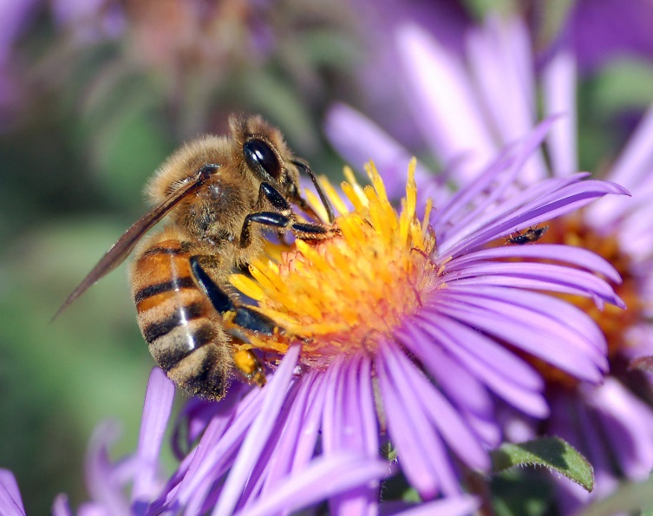
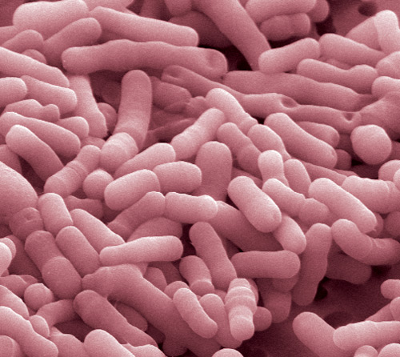
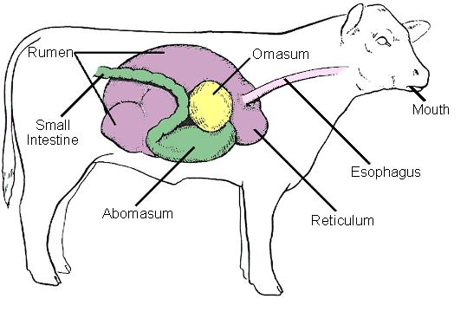
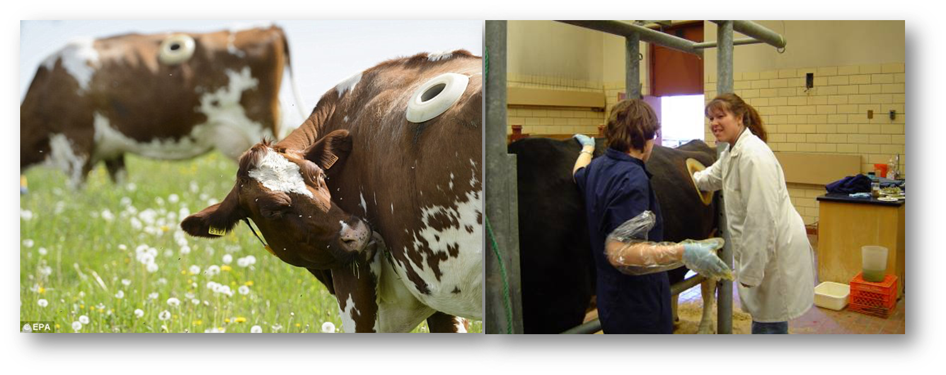
Species interactions
Mutualism
When both species mutually benefit from the interaction
The relationship is (+ +) positive for both
Pollinators get nectar, plants spread pollen
e.g., ungulates and intestinal bacteria
Holey cow!
Notes:
Optional, Discuss mutualisms and how both species benefit from this interaction.

Slide 4
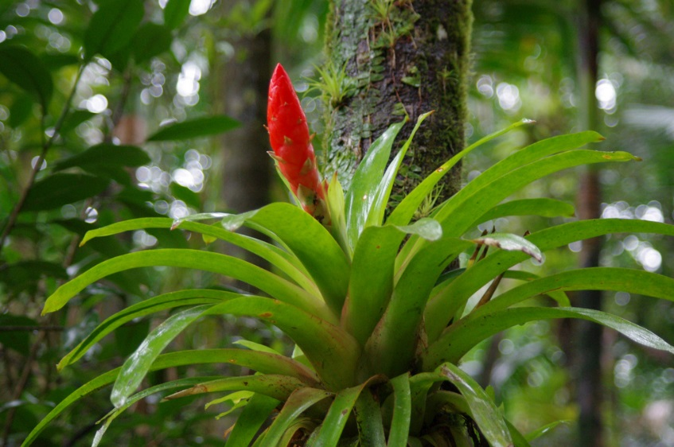
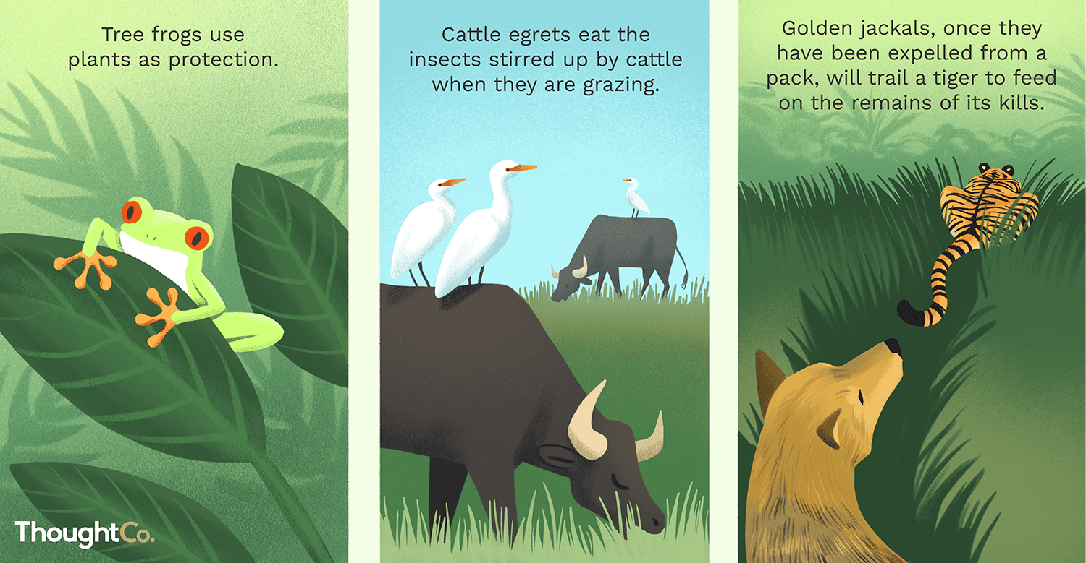
Species interactions
Commensalism
When one species benefits and the other is unaffected
The relationship is (+ 0): beneficial for one, neutral for the other
e.g., orchids benefit from growing on trees, but trees are unaffected
Notes:
Optional, Discuss commensalism and how one species benefits and the other is not affected.

Slide 5
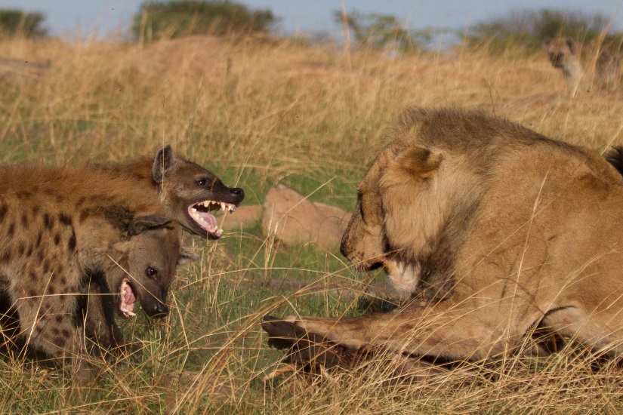
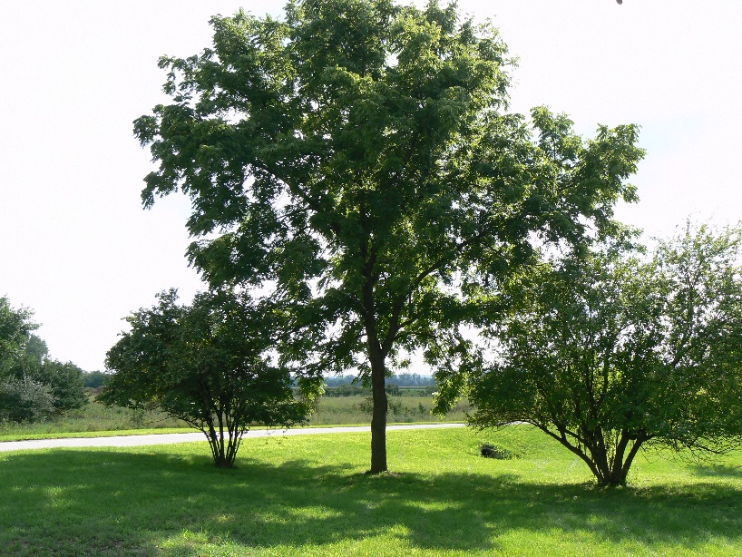
Species interactions
Competition is detrimental to the populations of both species (− −)
Both species compete for a resource or resources
Amensalism is detrimental to one species while the other is unaffected (− 0)
Asymmetric competition
Taller plant species shades a shorter plant species
Notes:
Optional, Discuss competition and amensalism, which negatively affects both species or negatively affects one species and does not affect the other species, respectively.

Slide 6
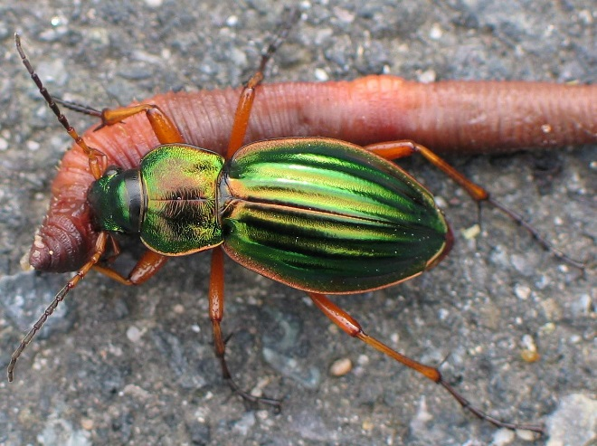
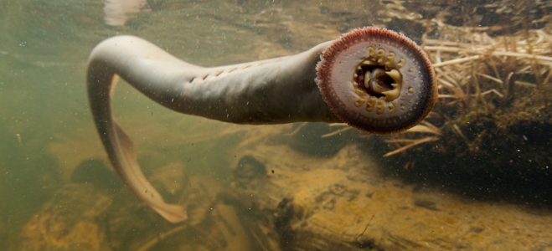
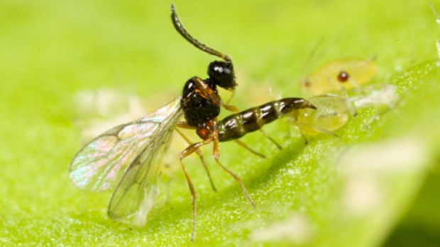
Species interactions
There are multiple types of relationships where one species benefits, but the other is harmed (+ −)
Predation
One species feeds on another, killing it
Parasitism
One species feeds on another, reducing its fitness but not killing it
Brood parasitism: one species trick other species into raising their young (e.g., cuckoos)
Parasitoidism
One species uses another for reproduction, and its larvae feed on it, eventually killing it
Notes:
Optional, Discuss species interactions where one species benefits and the other is harmed, including predation, parasitism, and parasitoidism. For an ecology class, brood parasitism is also one specific case that students often find interesting.

