Slide 1
Plant hairs or trichomes
Plant hairs are called trichomes
(pronounced: try-combs).
Some trichomes are factories that produce different types of chemicals that provide flavors, have medicinal properties, or are used in household items. In many herbs, such as oregano, the trichomes are sunken into the surface of the leaf.

Slide 2
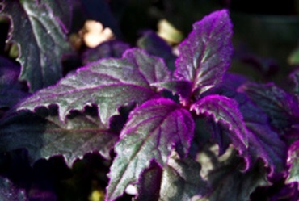
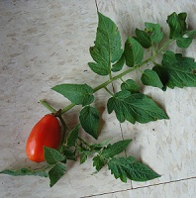
Plant trichome types and forms
Plant trichomes originate from the plant epidermis. They all come in a variety of shapes and forms.
Examples:
Arabidopsis - single-celled trichomes
Purple passion plants – multi-celled trichomes
Tomato – different types of glandular trichomes

Slide 3
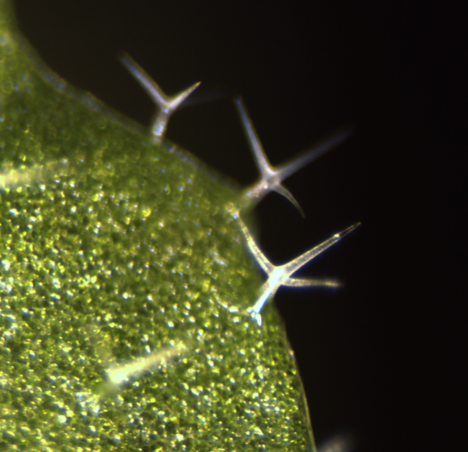
The mouse-ear cress (Arabidopsis thaliana) has single-celled multi-pointed trichomes that project from the outer layer of cells. Interestingly, the cells of these trichomes are polyploid.

Slide 4
The purple passion plant has multicellular trichomes that contain a purple pigment.

Slide 5
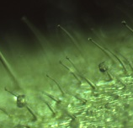
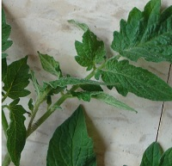
The cultivated tomato (Solanum lycopersicum) has four different types of trichomes. Some of these are glandular
with globular heads on a short stalk. The globular portion is composed of secretory cells that contain chemicals.

Slide 6
Trichomes as protection
Trichomes deter chewing insects, caterpillars, and fungal infections.
They also help prevent damage from frost, drought, and UV light.

Slide 7
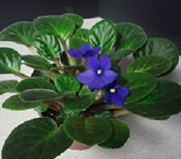
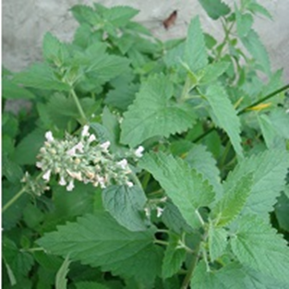
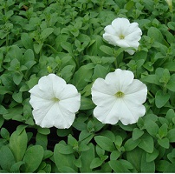
Trichomes as deterrents
Trichomes deter chewing insects, caterpillars, and fungal infections. They also help prevent damage from frost, and drought.
Examples:
African violet
Catnip
Petunia

Slide 8
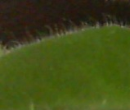
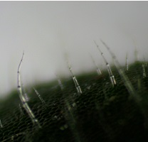
African violet (Saintpaulias sp.) has dense pointed trichomes on the leaf surface. The clear trichomes shown here contain chemicals that absorb UV light and act as a sunscreen.

Slide 9
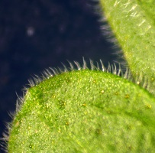
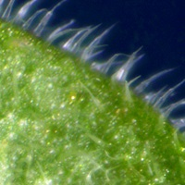
Catnip (Nepeta cataria) has pointed trichomes all over the surface of the leaf.

Slide 10
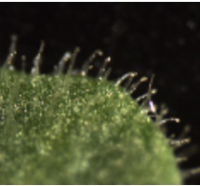
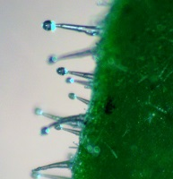
Petunia (Petunia hybrida) has round-tipped trichomes filled with sticky substances that deter insects.

Slide 11
Confocal/fluorescence microscopy of trichomes.
Some trichomes contain chemical that absorb the UV light and then emit blue light (or fluoresce) when viewed with the confocal/fluorescence microscope.
This is called autofluorescence because it occurs with the plant’s natural chemicals and does not require any staining.

Slide 12
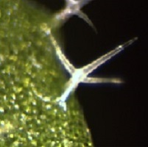
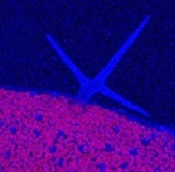
In this Arabidopsis trichome, a beam of UV light is absorbed by a chemical which fluoresces a blue color. Also, note that the chlorophyll in chloroplasts also fluoresces pink, when excited with light ~465 nm.

Slide 13
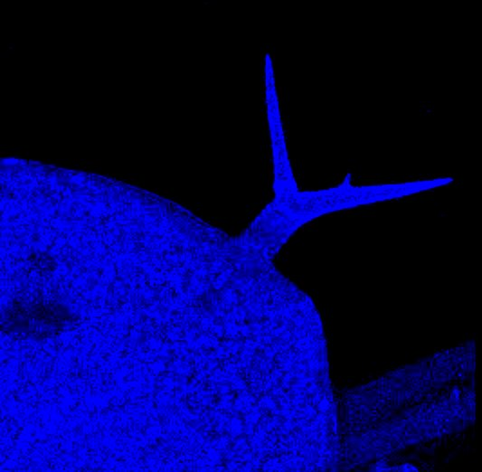
In confocal/fluorescence microscopy, a series of 4-7 µm optical sections is merged to provide the entire image of the trichome.
Focusing through a plant hair.
Merged image.

Slide 14
Trichomes protect plants from UV light.
UV-absorption protect plants from UV light acting as a type of sunscreen.
The following images show confocal imaging of the trichomes for:
Arabidopsis African violet
Catnip Oregano
Pumpkin Purple passion plant
Soybean

Slide 15
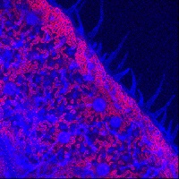
Catnip (Nepeta cataria) has pointed trichomes and round (pellate) trichomes embedded in the leaf surface. Both types of trichomes fluoresce blue under the confocal microscope.

Slide 16
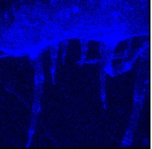
African violet (Saintpaulias sp.) has dense pointed trichomes on the leaf surface. The clear trichomes shown here contain chemicals that absorb UV light and act as a sunscreen.

Slide 17
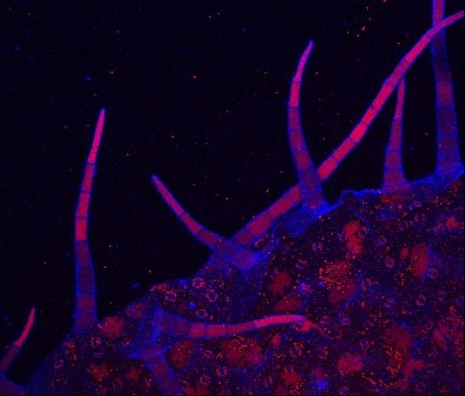
Trichomes of the purple passion plant (Gynura aurantiaca) fluoresce blue under UV light, while the purple pigment fluoresces bright pink.

Slide 18
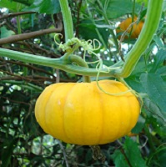
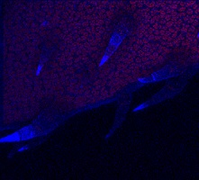
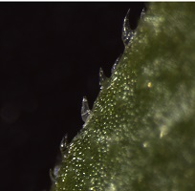
Pumpkin (Cucurbita pepo) has short, sharp trichomes. The trichome tips fluoresce brightly.

Slide 19
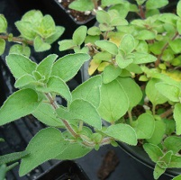
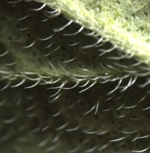
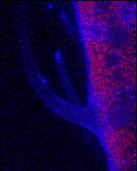
Oregano (Origanum vulgare) has hairs along its leaf veins and sunken trichomes, both fluoresce blue.

Slide 20
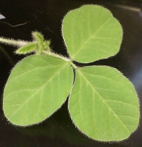
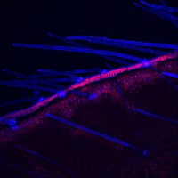
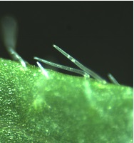
Soybean (Glycine max) has long thin multicellular trichomes, which fluoresce blue.

Slide 21
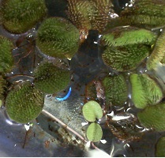
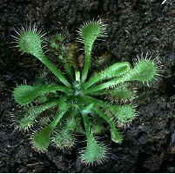
Unique Trichomes
Some trichomes have interesting shapes for other uses.
Examples:
Salvinia – an aquatic plant
Sundew – a carnivorous plant

Slide 22
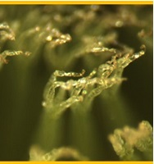
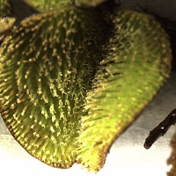
Salvinia (Salvinia sp.) has tree or hand-shaped trichomes on the top of the leaf. These trichomes hold air pockets and prevent the leaves from being submerged.

Slide 23
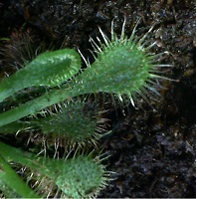
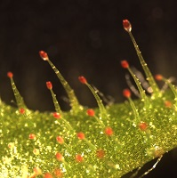
Sundew (Drosera sp.) are carnivorous plants. The red-tipped trichomes lure insects to the leaves. The sticky trichomes trap the insects and make enzymes that digest them, providing nitrogen to the plant.

Slide 24
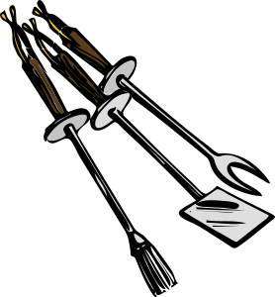
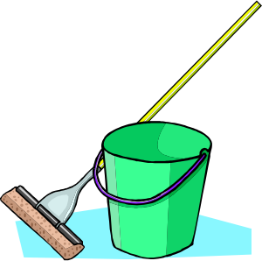
Trichomes as biochemical factories.
Trichomes that produce different types of chemicals, often have been useful to humans.
The chemicals provide flavors, have medicinal properties, or are used in household items.
Flavor
Menthol
Carvacrol (oregano)
Eucalyptol
Steviol (in stevia)
Essential oils
Household
Limonene
Cotton fibers
Pinene
Insect deterrents
Medicinal
Antioxidants
Antimicrobials
Antimalarial
Cannabinoids

Slide 25
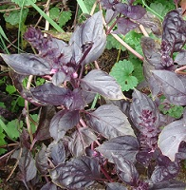
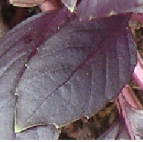
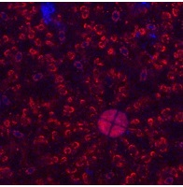
The trichome from sweet basil are sunken into the epidermis. The confocal image shows that the trichome consists of 4 cells.

Slide 26
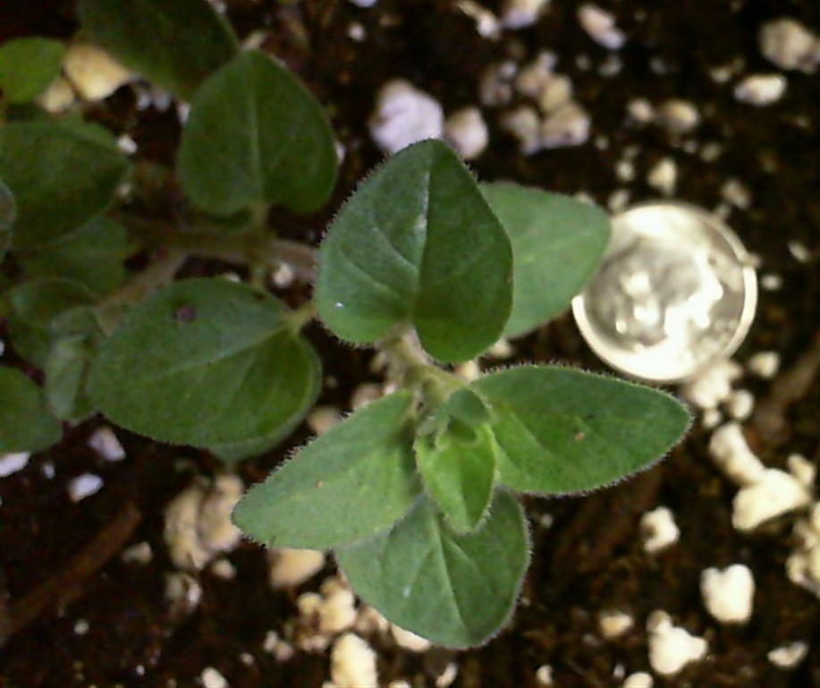
In oregano the trichome that contain the chemicals that produce flavor and aroma appear are bright balls sunken into the leaf surface.

Slide 27
References
Glas JJ, BCJ Schimmel, JM Alba, R Escobar-Bravo, RC Schuurink, and MR Kant. (2012) Plant glandular trichomes as targets for breeding or engineering of resistance to herbivors. Int. J. Mol. Sci. 13: 17077-17103 DOI: 10.3390/ijms131217077
Sinlapadech T, J Stout, M Ruegger, M Deak, and C Chapple (2007) The hyper-fluorescent trichome phenotype of the brt1 mutant of Arabidopsis is the result of a defect in a sinapic acid: UDPG glucosyltransferase. Plant Journal. 49(4):655-68.

Slide 28
Acknowledgements
Marcia Harrison-Pitaniello thanks the John Deaver Drinko Academy at Marshall University for funding her ongoing efforts to develop and publish curricular materials. She also wishes to thank Terry Shank, Angela Kargul, Danielle Gallagher, and Susan Weinstein for their helpful input on this material.

